Slide 1
Local Governance in the Swiss Federal System
Prof. Andreas Ladner
Lausanne, 27.2.2020

Slide 2
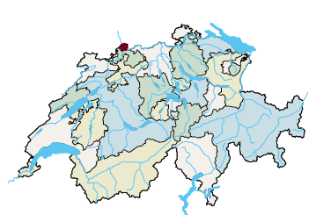
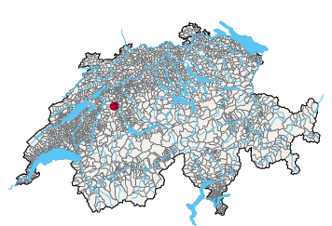
26 cantons (and 2202 municipalities)

Slide 3
Inhabitants (8,2 million)
Quelle: www.badac.ch
Notes:
Vergleich Germann: Grosse Unterschiede zwischen den Kantonen. Zürich: ein sechstel der Schweiz, wirtschaftlich ein Viertel. Ohne Zürich läuft nichts in diesem Staat.
Die Staat Zürich wäre auf Platz 7.
Die Stadt Zürich wäre der siebentgrösste Kanton!
=> vgl. Diskussion Reform des Ständemehrs, Stellung der Städte im Staat

Slide 4
Size of municipalities (%)

Slide 5
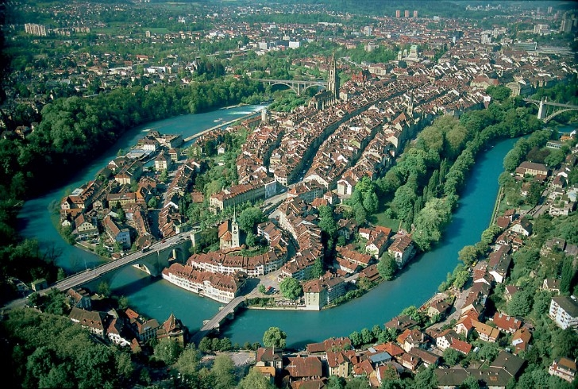
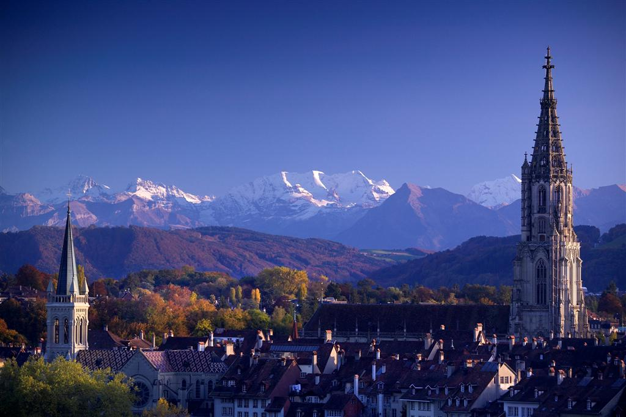
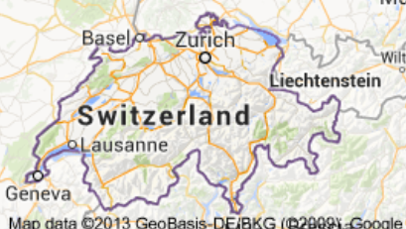
Bern: federal capital, seat of governemnt

Slide 6
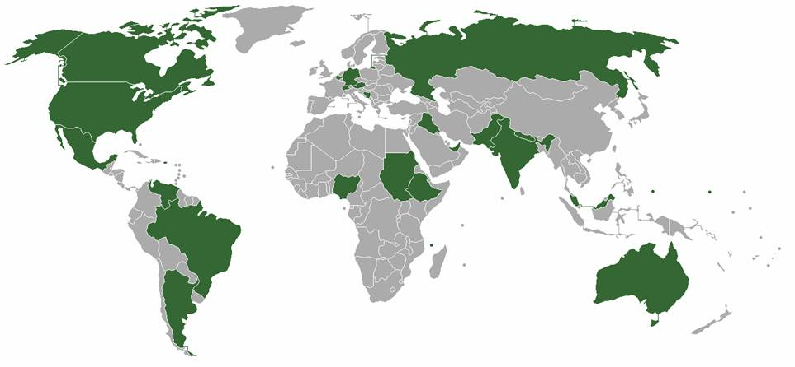
Federalist countries

Slide 7
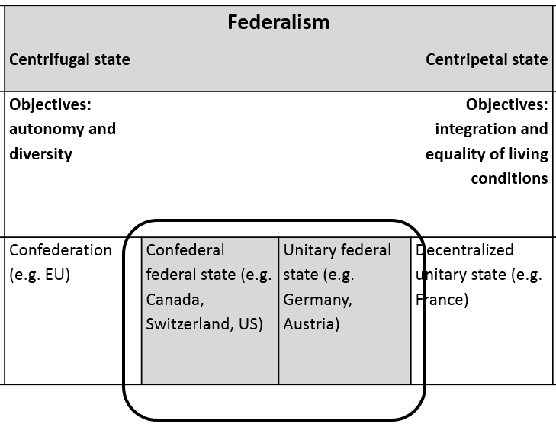
Autonomy and diversity instead of equality of living conditions
Quelle: Stalder, Kurt (1999). Föderalismus und Finanzausgleich. Schriftenreihe der Fachgruppe für kantonale Finanzfragen. Solothurn: Verlag FkF.

Slide 8
Swiss Federalism: basic characteristics
The existence of the cantons is guaranteed
The cantons are free to organize themselves internally
The cantons elect their own authorities
The cantons dispose of far reaching competences
The cantons dispose of their own financial resources
There is no political control ruling over the cantons
The cantons participate equally in the decision making process on federal level

Slide 9
Competition and solidarity between the different federal units
Diversity and fiscal autonomy (competition)
Equalization of differences on the basis of minimal standards (solidarity)

Slide 10
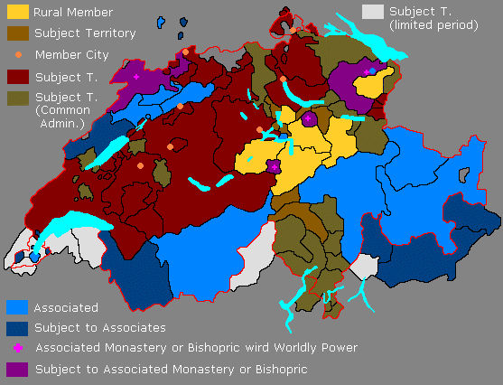
The ancient political system in Switzerland
Source: http://history-switzerland.geschichte-schweiz.ch/swiss-revolution-helvetic-republic-1798.html

Slide 11
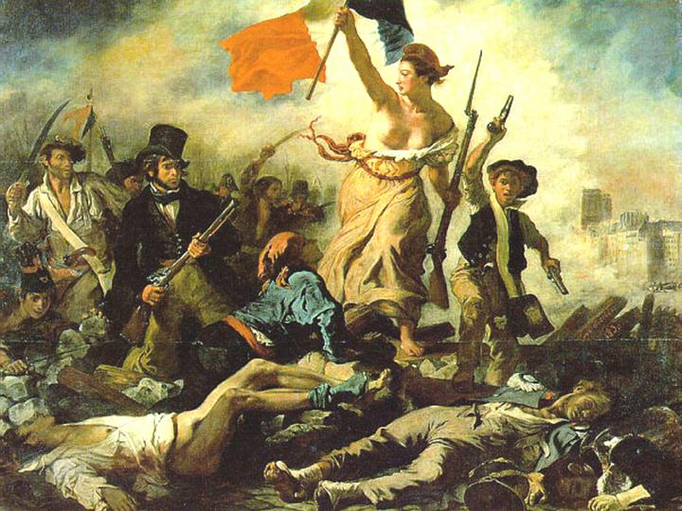
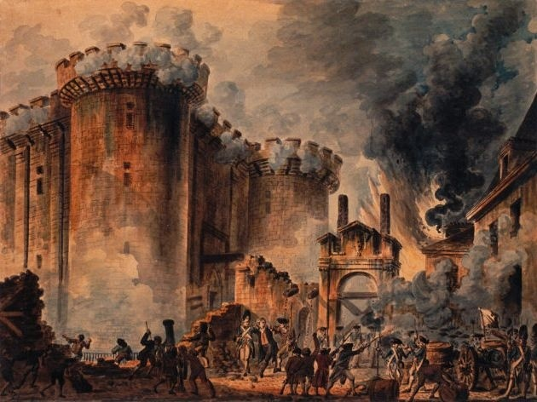
French Revolution (1789)
The Storming of the Bastille, July 14, 1789

Slide 12
The foundation of the modern national state (1848)
Tensions between the liberal Protestant and the Catholic cantons lead to the civil war in 1847 (the “Sonderbundskrieg”).
After a brief military campaign with federal troops, the Catholics, who had founded a separatist federation, surrender.
1848 The modern Swiss federal state is founded in 1848. Its constitution centralizes and harmonizes numerous areas which were previously the responsibility of the cantons, such as military service, customs, and postal services and coinage.
This leads to the creation of a cohesive territory ripe for economic development.

Slide 13
From a Confederation to a Federal State
Federalism, the only solution
Two chambers (following the US example)
Very limited power for the central state
Modification of the Constitution have to be accepted by the cantons and the citizens
Residual competences in the hand of the cantons (“bottom-up federalism”) -> diversity
Equalization of differences

Slide 14
Confederation, cantons and municipalities: the three levels of the state
Revenue, expenditures and transfers

Slide 15
22.0 mrd.
2014/2013
National gov.
rev.: 64.9 mrd.
exp.: 64.7 mrd.
National tasks:
defense, IR, social security
_____
Cantonal tasks:
education, health, police
_____
Local tasks
primary school,
social assistance, land use, water, waste etc.
29 mrd.
TVA
Income Tax
18.3 mrd.
24.7 mrd.
Cantonal govs.
rev.: 82.7 mrd.
exp.: 85.0 mrd.
42.3 mrd.
74.1 mrd.
3 mrd.
26.0 mrd.
Local govs.
rev.: 45.5 mrd.
exp.: 46.1 mrd.
37.3 mrd.
Citizens
1 Mrd.= 1’000’000’000
Social Security not included (59.8 mrd.) Health systems only partly included

Slide 16
How are the different tasks allocated to the different levels?
(Principle of subsidiarity)

Slide 17
National tasks
Defence
Foreign policy/IR
Railway system
National Motorways
Nuclear power plants
Scientific research
Etc.

Slide 18
Cantonal tasks
Health
Education
Police
Roads
Social security
….
Execution of national policies

Slide 19
Tasks of Swiss municipalities
Education: kindergarten, primary school, secondary school
Social welfare and health
Water, electricity, and traffic
Planning and construction, sport and culture
Municipal police (fire, roads, and commerce)
Naturalisation (“swiss maker”)
Internal organization, financial managemet
Execution of higher level tasks

Slide 20
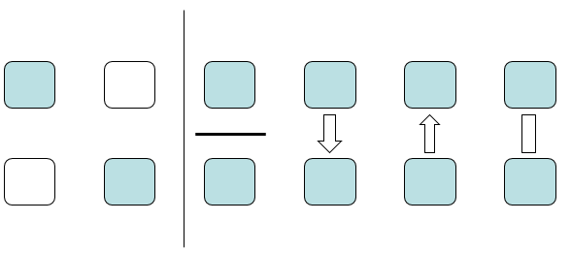
Different forms of «cooperation»
National level
Cantonal level
Dual Federalism
Cooperative Federalism

Slide 21
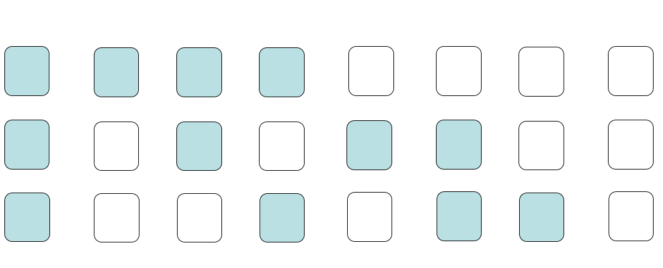
Multi-level governance

Slide 22
The three components of a public tasks
Deciding/regulating
Doing/executing
Paying/Funding
Who/which level does what?

Slide 23
Central-local relations: problems
«Who pays the fiddler, calls the tune»
Principal-agent problem
Executing and funding without deciding is not very satisfying

Slide 24
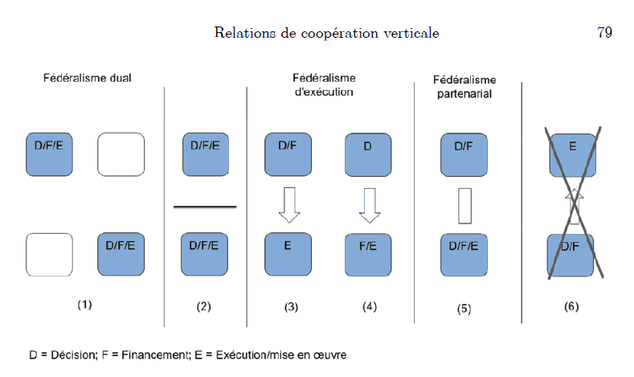
Two levels

Slide 25
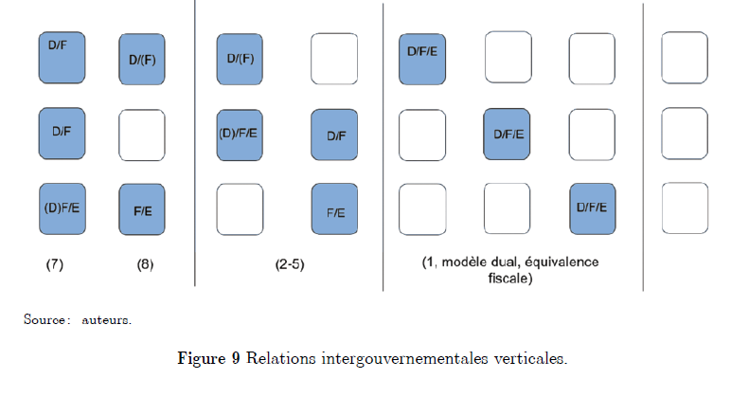
Three levels

Slide 26
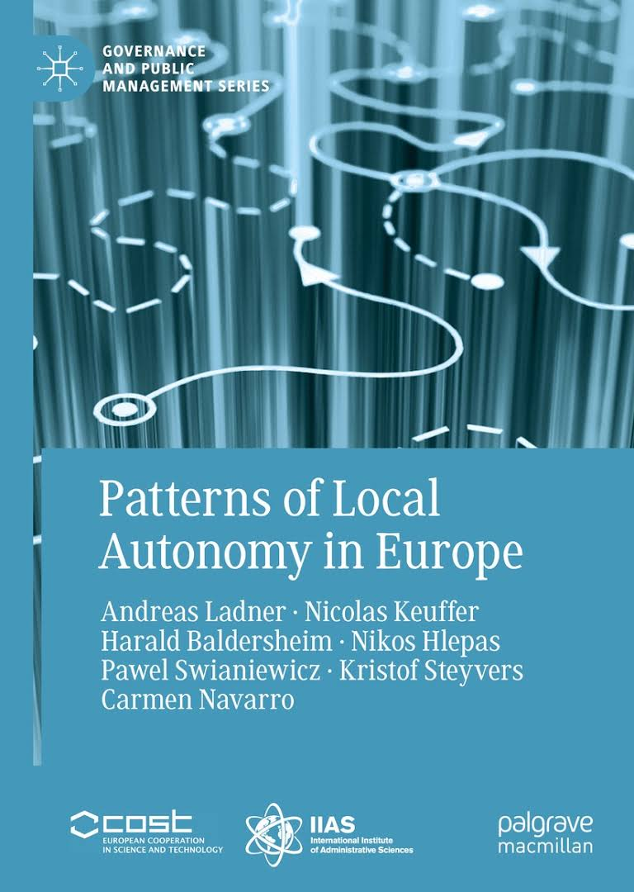

Slide 27
Indicators of local autonomy
Institutional depth (ID): The extent to which local government is formally autonomous and can choose the tasks they want to perform.
Policy scope (PS): Range of functions (tasks) where local government is effectively involved in the delivery of the services (be it through their own financial resources and/or through their own staff.
Effective political discretion (EPD): The extent to which local government has real influence (can decide on service aspects) over these functions.
Fiscal autonomy (FA): The extent to which local government can independently tax its population.
Financial transfer system (FTS): The proportion of unconditional financial transfers to total financial transfers received by the local government.

Slide 28
Indicators of local autonomy
Financial self-reliance (FSR): The proportion of local government revenues derived from own/local sources (taxes, fees, charges).
Borrowing autonomy (BA): The extent to which local government can borrow.
Organisational autonomy (OA): The extent to which local government is free to decide about its own organisation and electoral system.
Legal protection (LP): Existence of constitutional or legal means to assert local autonomy.
Administrative supervision (AS): Unobtrusive administrative supervision of local government.
Central or regional access (CRA): To what extent local authorities are consulted to influence higher level governments’ policy-making.

Slide 29
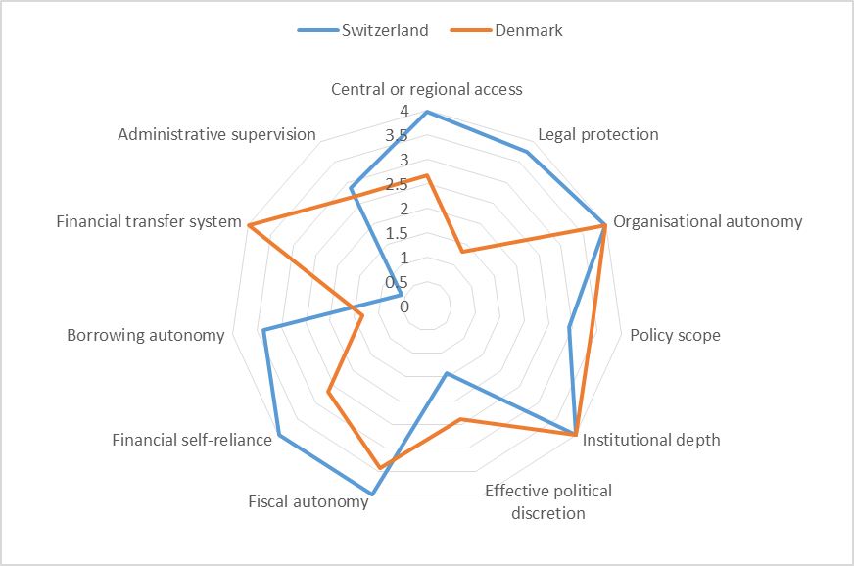

Slide 30
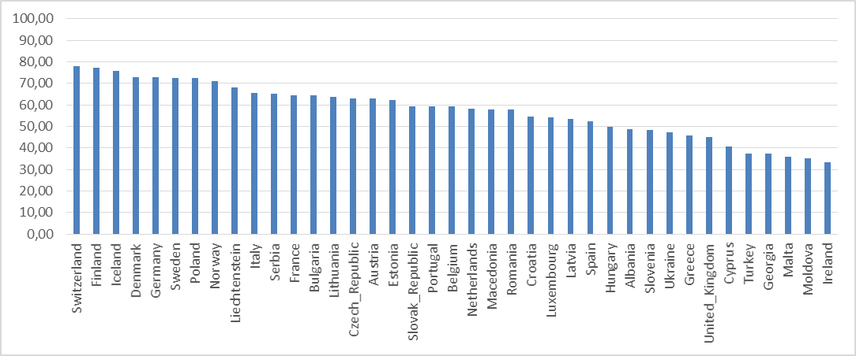
«Country Ranking 2014»

Slide 31
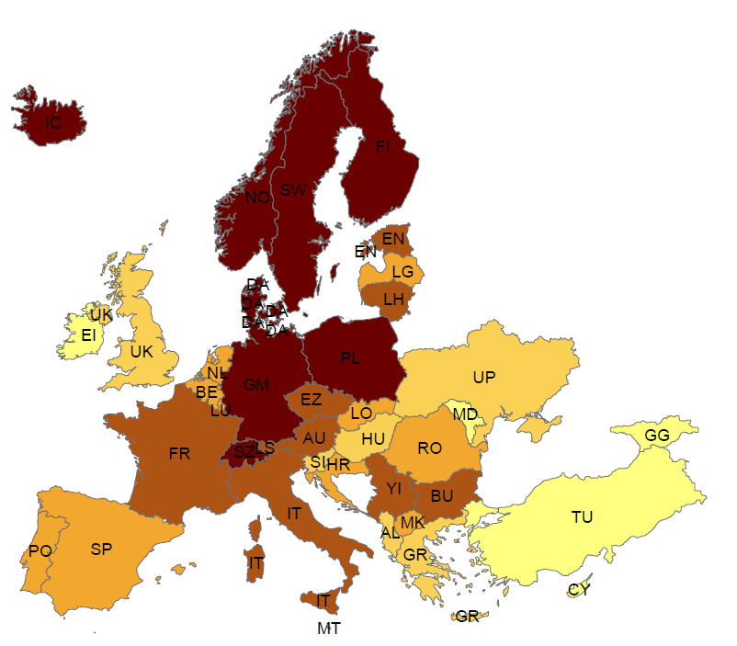
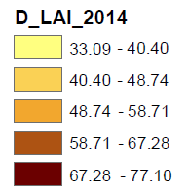
Local autonomy index (LAI_2014)

Slide 32
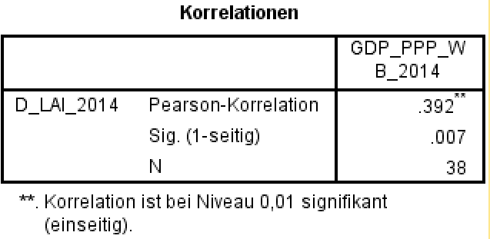
Local autonomy and GDP_PPP

Slide 33
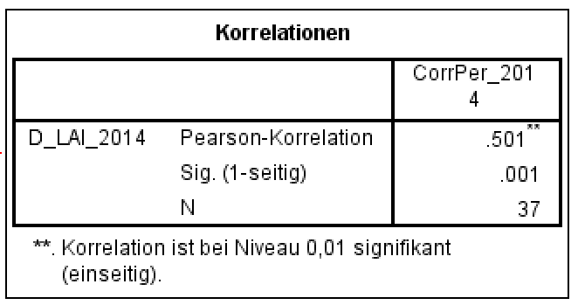
Local autonomy and corruption

Slide 34
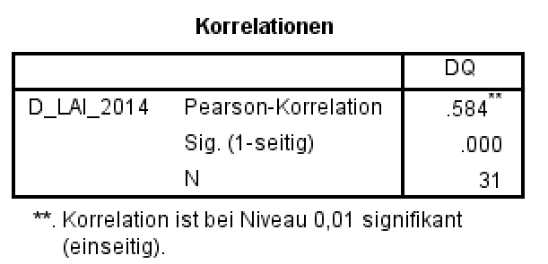
Local autonomy and democracy

Slide 35
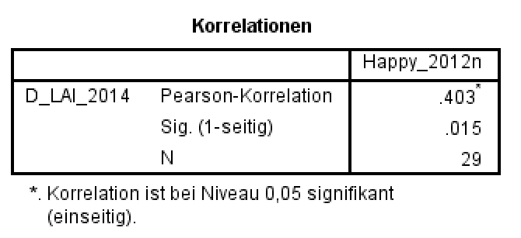
Local autonomy and happyness

Slide 36
But …
Decentralization does not automatically lead to economic success. Both are results of long, continuing and interdependent processes
Autonomy goes hand in hand with diversity
Diversity needs mechanisms of equalization

Slide 37
Citizens/tax payers – Local authorities/civil servants
Another important relation

Slide 38
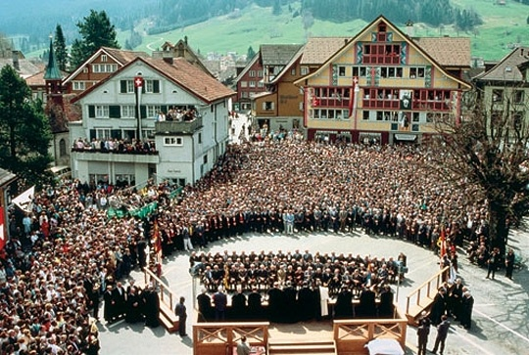
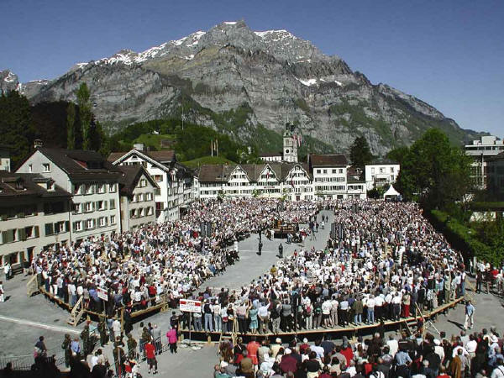
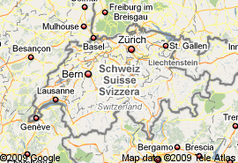
Citzens and Direct Democracy: “Landsgemeinde” (cantonal level)
AI
GL

Slide 39
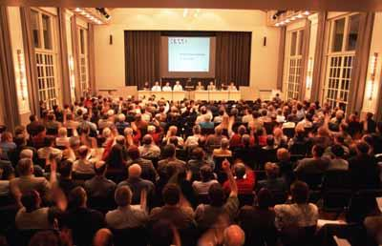
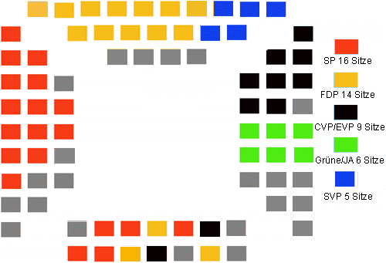
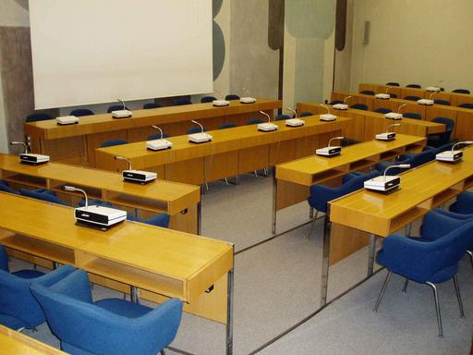
Two different political systems at the local level
Baar: 20,266 inhabitants
Olten: 17,000 inhabitants
Municipal assembly
Local parliament
(81.9 % of the municipalities)
(18.1 % of the municipalities)

Slide 40
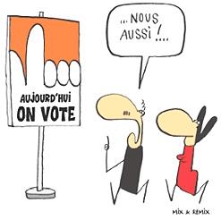
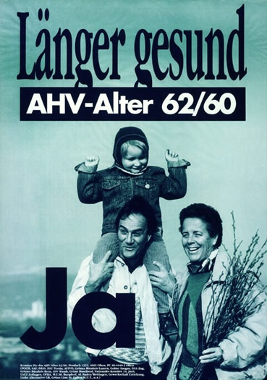
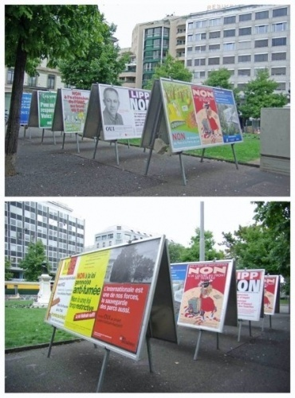
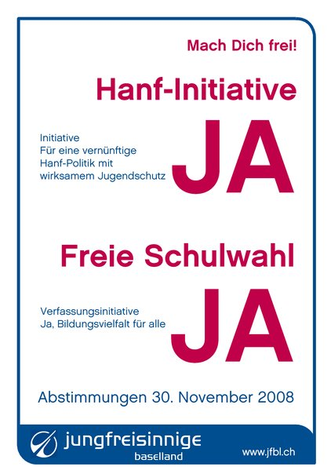
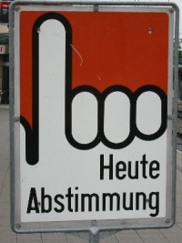
Direct Democracy: Referendums and initiatives

Slide 41
The compulsory referendum (obligatorisches Referendum):
Changes of the local code (Gemeindeordnung) and important public expenditures have to be brought to a vote.
Any expenditures or projects exceeding 10 Mio. sFr. or recurrent expenditures of more than 500'000 sFr. have necessarily to be accepted by the citizens.

Slide 42
The optional referendum (fakultatives Referendum):
A (positive) decision of the city's parliament can be questioned with a referendum
a) when a majority of the members of parliament decide so during the same session,
b) when within 20 days after the official announcement of this decision at least 4000 citizens demand a vote, and
c) when within 20 days one third of the members of parliament asks for it (written request).

Slide 43
The popular initiative (Volksinitiative):
Within a laps of time of six month 4000 citizens (those entitled to vote) have to sign a request.
If this request aims at something which is in the domain of the compulsory referendum, it is put to a vote of the citizens.
If it aims at something which is in the domain of the optional referendum, the decision is in the hands of parliament.

Slide 44
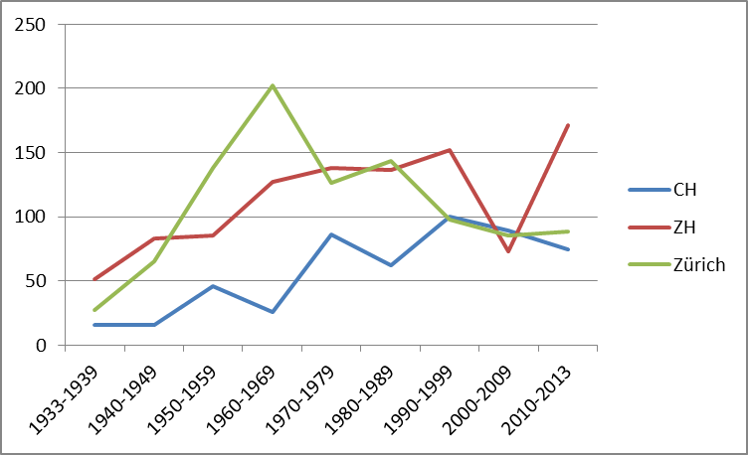
Development issues per level 1933-2020*

Slide 45
An enormous amount of decisions to be taken
In his/her politically active life a citizens is asked to decide on between 1600 and 1800 issues.

Slide 46
Thank you for your attention and your participation!

