Slide 1
Local Autonomy and How to Measure it?
Comparative Public Administration
Lausanne, 24.9.2021
Prof. Dr. Andreas Ladner, IDHEAP

Slide 2

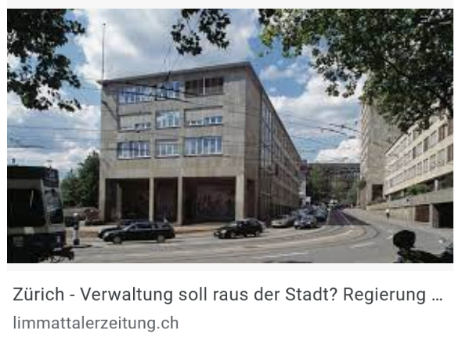
Intro
“Dual-comparative” research project

Slide 3

Local autonomy

Slide 4
Local Autonomy (LA), a Key Notion of Various Current Debates
Basically, LA affirms the administrative and decision-making freedom of public governing bodies, called local because they are “distinct” from the State, and sub-national from a geographical and legal standpoint (Guérard 2016)
LA is at the center of many debates, currently held at global, European, national and sub-national levels
  Division of competences within a state
  Normative values of the autonomous local government
  Shift from local government to local governance
  Territorial reforms and ideal size of local government to deliver services to citizens
Recurrent theme in scholarly researches, with a number of challenges related to the concept of LA being emphasized

Slide 5

Frok
From a normative perspective:

Slide 6
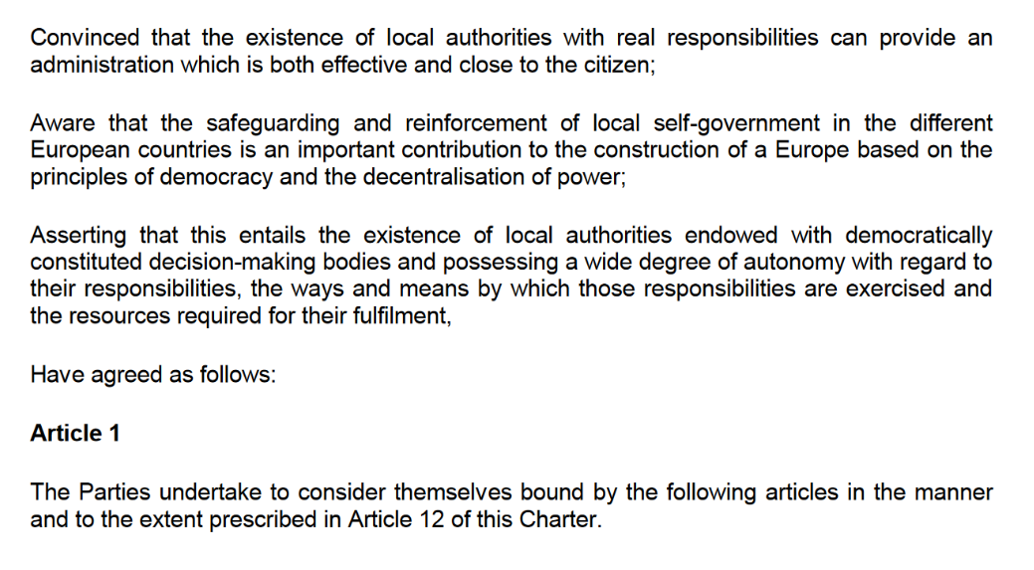

Slide 7
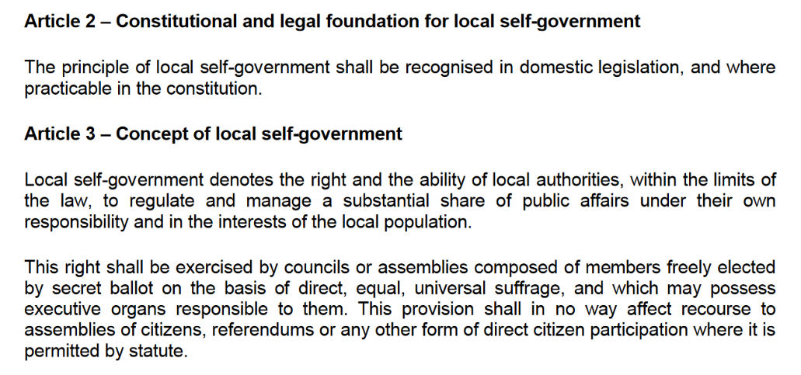

Slide 8
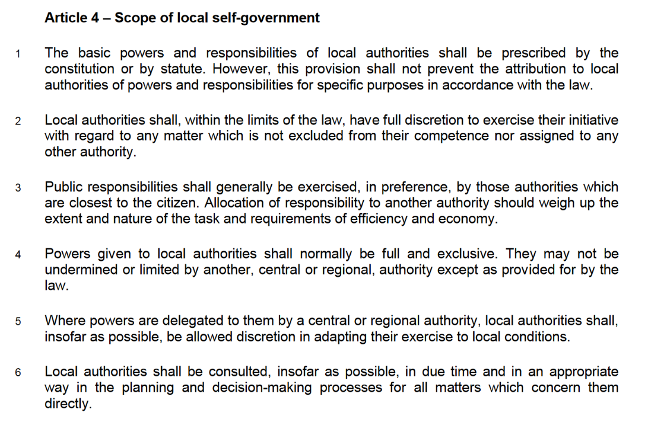

Slide 9
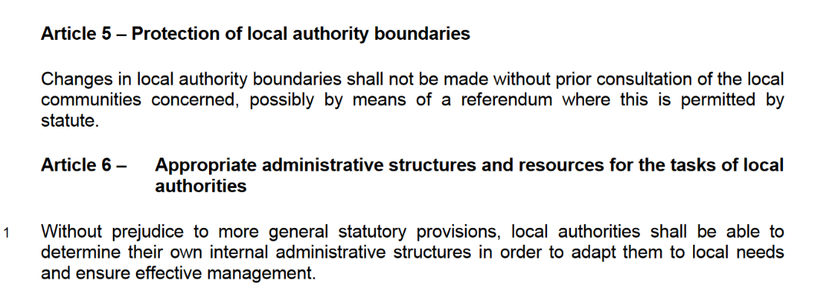
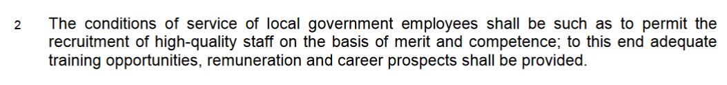

Slide 10
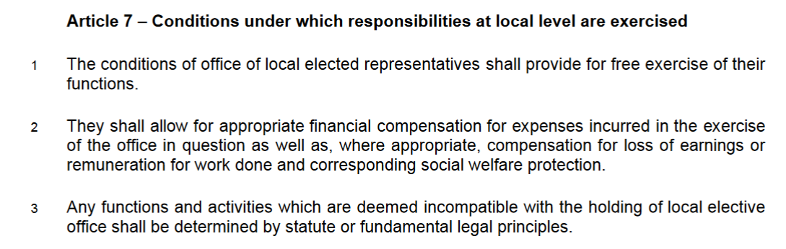

Slide 11
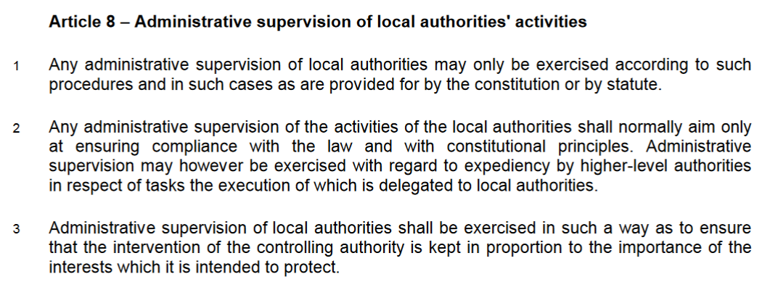

Slide 12
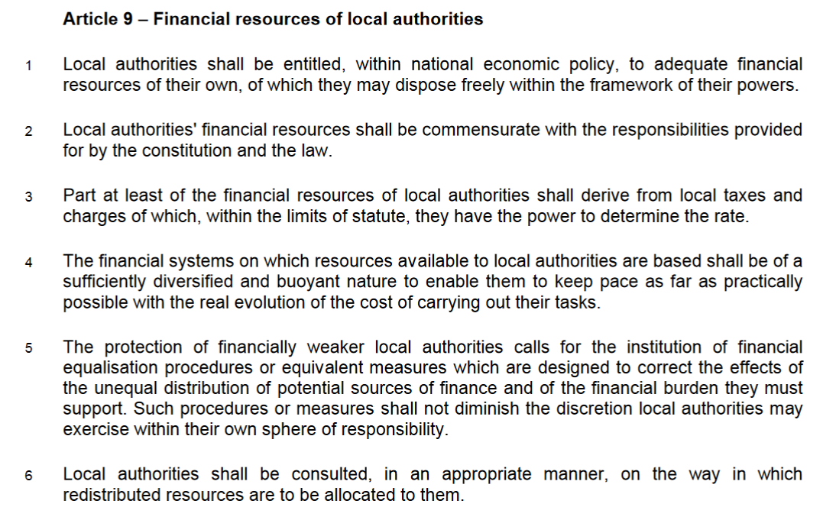
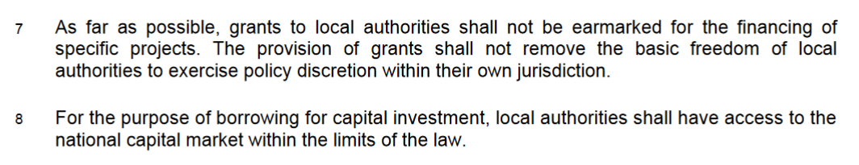

Slide 13
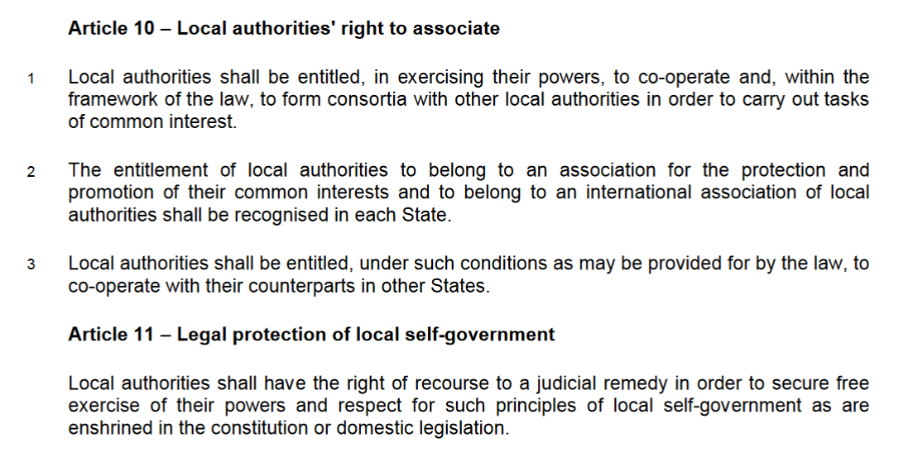

Slide 14
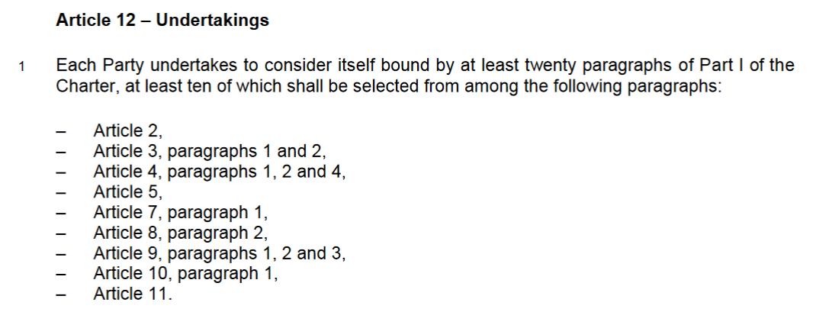
Ten of the following paragraphs have to be accepted

Slide 15
About half the countries signed the Charter without any reservations. The most frequent reservations concern:
article 4, paragraph 5 which demands that local authorities shall, “insofar as possible, be allowed discretion in adapting their exercise to local conditions”,
article 6, paragraph 2 which demands that the “conditions of service of local government employees shall be such as to permit the recruitment of high-quality staff on the basis of merit and competence; to this end adequate training opportunities, remuneration and career prospects shall be provided”,
article 7, paragraph 2 which demands that national regulations “shall allow for appropriate financial compensation for expenses incurred in the exercise of the office in question as well as, where appropriate, compensation for loss of earnings or remuneration for work done and corresponding social welfare protection”,
article 8, paragraph 2 which demands that “any administrative supervision of the activities of the local authorities shall normally aim only at ensuring compliance with the law and with constitutional principles. Administrative supervision may however be exercised with regard to expediency by higher-level authorities in respect of tasks the execution of which is delegated to local authorities”,
and the various paragraphs of article 9 which concerns the financial resources of local authorities, the principle of fiscal equivalence, the tax autonomy, financial equalization, non-conditional transfers and borrowing possibilities.

Slide 16
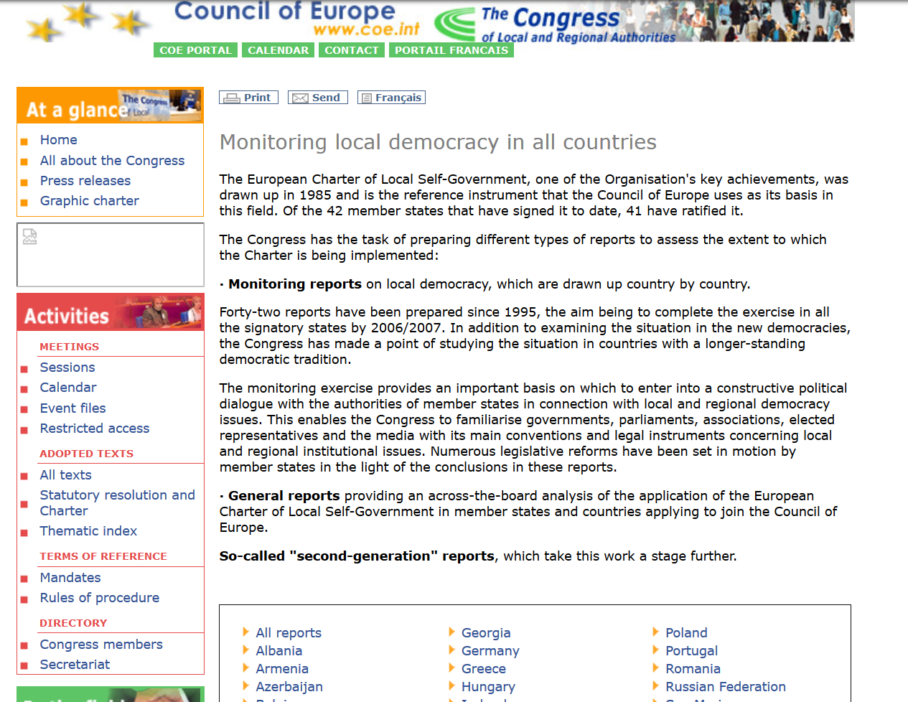

Slide 17
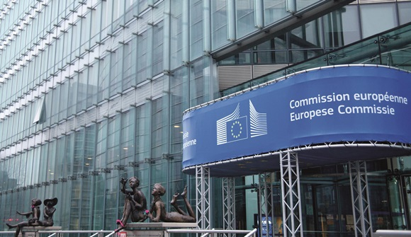
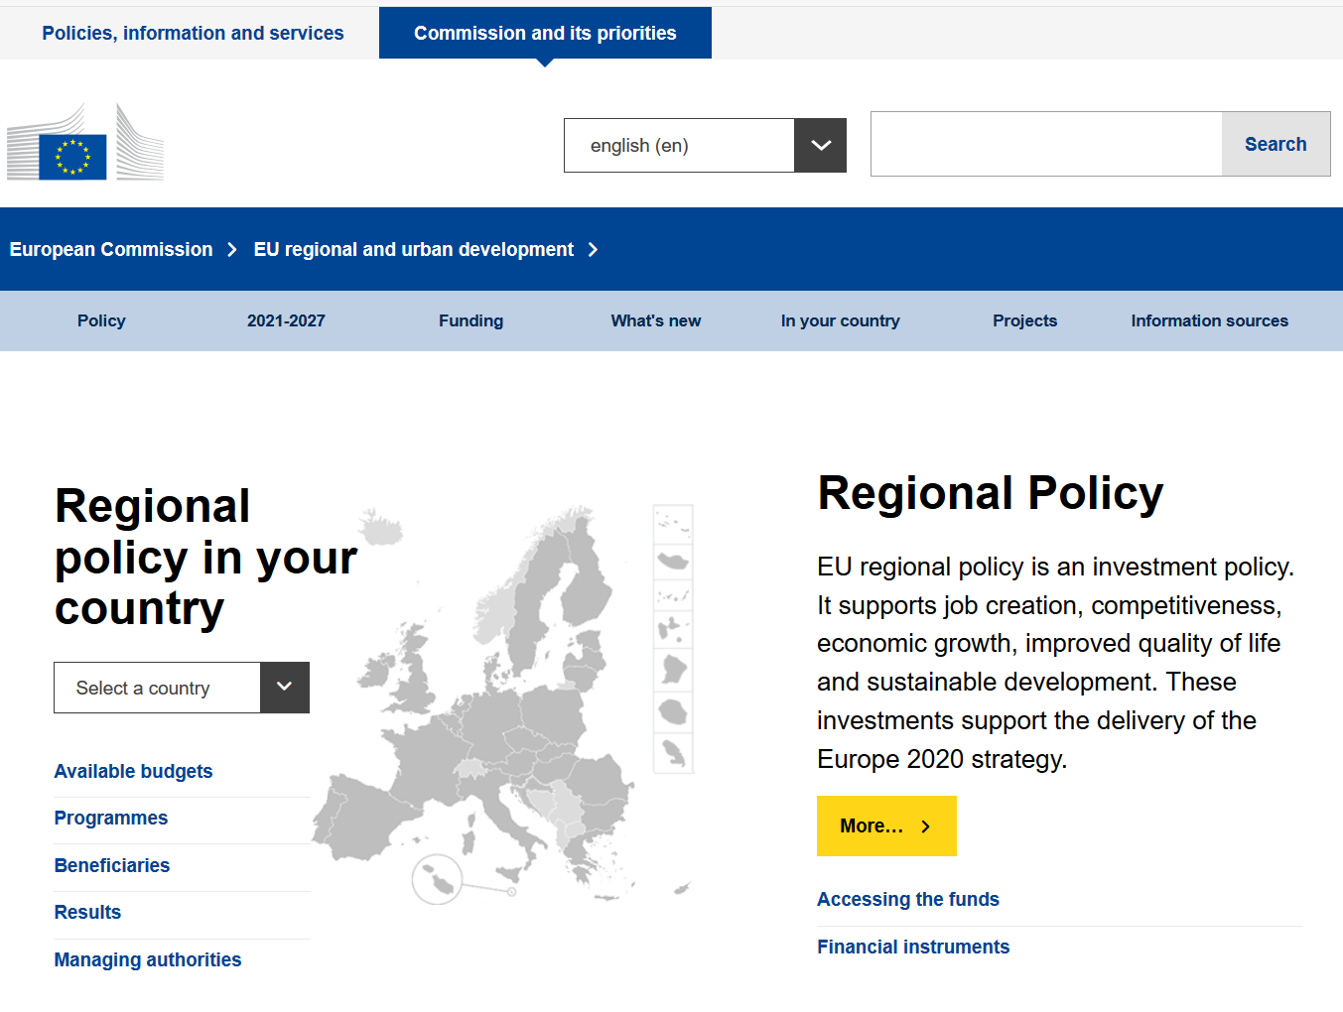

Slide 18
Mandate and interest of the European Commission
The study was initiated by the Directorate-General for Regional and Urban Policy of the European Commission (Tender No 2014.CE.16.BAT.031: “Self-rule Index for Local Authorities”).
Going beyond fiscal autonomy and local government expenditures as a percentage of total government expenditures
Big parts of the cohesion policy funding aim at improving institutional capacity and public administration, particularly on local level. Since the absorption rate of cohesion policy funding for the 2007–2013 has shown to be very low in some cases (European Commission 2014) and the expected goals could not be reached, it has become a key objective for the period 2014–2020 to strengthen local authorities.

Slide 19
Background to the LAI project
Report for the European Commission on the changes in amount of decentralisation in the EU, with a measure that goes beyond the share of funds managed by local authorities
Co-ordination of the project by Prof. Dr. Andreas Ladner and Dr. Nicolas Keuffer (IDHEAP), in close cooperation with Prof. Dr. Harald Baldersheim (University of Oslo)
A methodology that should correspond as closely as possible with the one of the Regional Authority Index (RAI)
A large scope: 39 countries and 25 years (1990-2014) covered
One year to collect the data, from October 2014 to November 2015

Slide 20
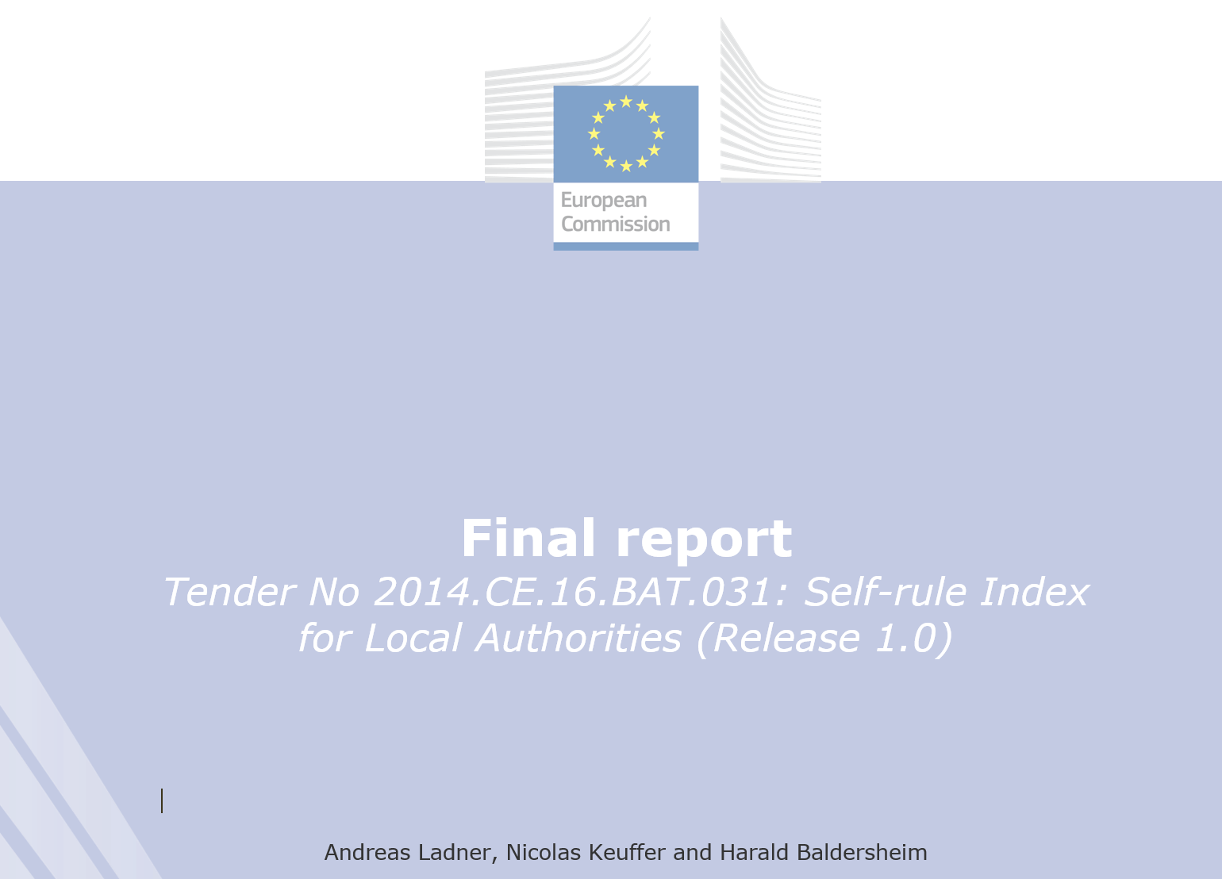

Slide 21
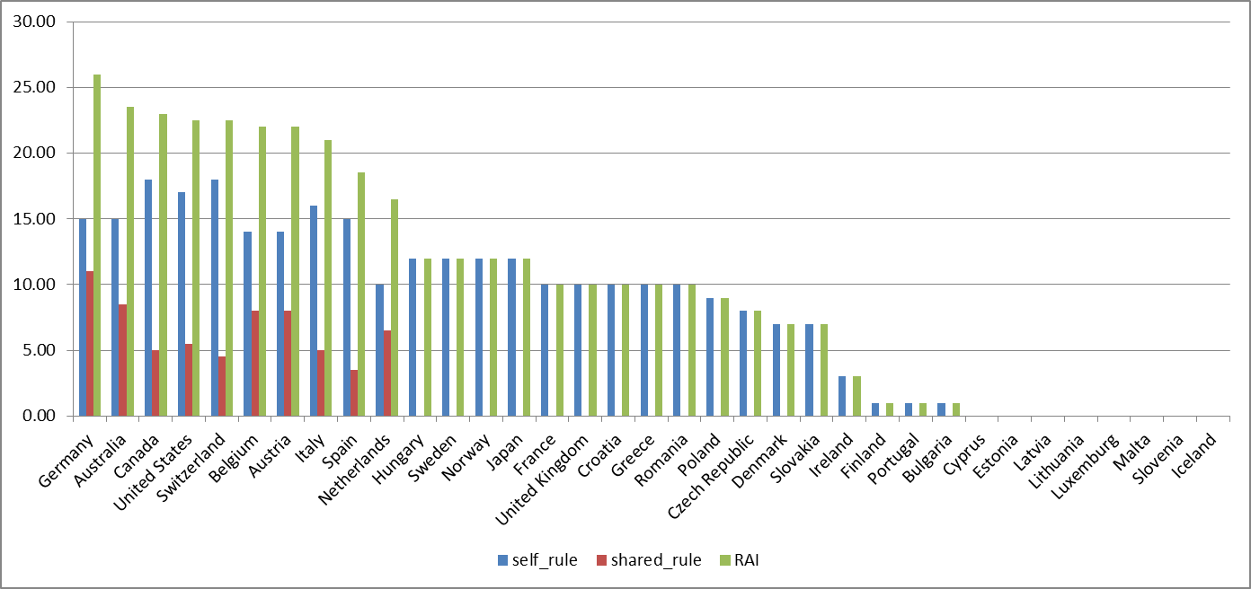
Hooghe et al.: Regional Authority Index
Source: Hooghe, Liesbet, Gary Marks, Arjan H. Schakel, Sandra Chapman, Sara Niedzwiecki, Sarah Shair-Rosenfield (forthcoming). Governance Below the Stat : Regional Authority in 81 Countries. Oxford: OUP. Estimations personnelles, écart d’agrégation

Slide 22
Theoretical Concerns

Slide 23
The Legalistic Approach and the “Old” Institutionalism
Local Autonomy as the “Freedom from”, “Freedom to” and “Reflection of Local Identity” (Pratchett 2004)
Clark (1984): The power of initiation and the power of immunity
Gurr and King (1987): autonomy has a vertical dimension (Type II autonomy) and horizontal dimension (Type I autonomy)

Slide 24
The Functional Approach, Economic Theories and Politikverflechtung
Decentralisation theories (Oates 1990, Buchanan 1950, Tiebout 1956, Musgrave 1959)
Many shared tasks (Politikverflechtung) (Scharpf 1978)
Local government as the range of functions (Vetter 2007)

Slide 25
The Organisational Approach, Democracy and Governance
First, “contextual conditions” referring to the general judicial, socio-economic and historical determinants
Second, “structural conditions” which have to do with the relative position of local governments in terms of functional responsibilities and financial autonomy. This factor overlaps with the idea of fiscal decentralization.
Third, “institutional conditions” related to the size of local government, its internal organisation, financial budget and infrastructure
Last, the “human resource conditions” which refer basically to personnel management considerations (Reddy et al. 2015: 162)

Slide 26
The Politics Approach of Intergovernmental Relations and the Veto Players’ Theory
Local Government as veto players (Tsebelis 1995)
Organisation of central control (Goldsmith 2002)
Direct and indirect channels to influence higher level decisions (Page 1991)

Slide 27
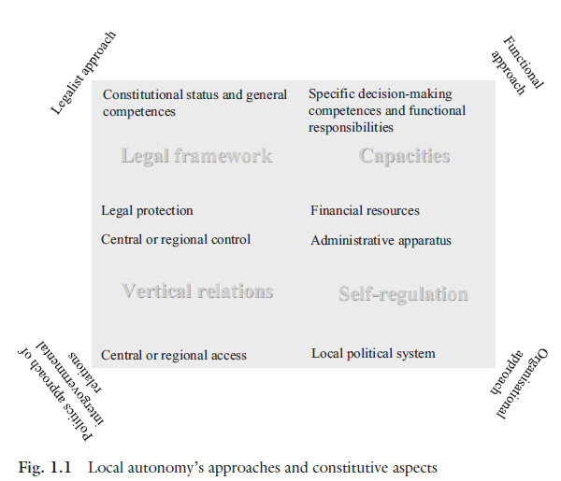

Slide 28
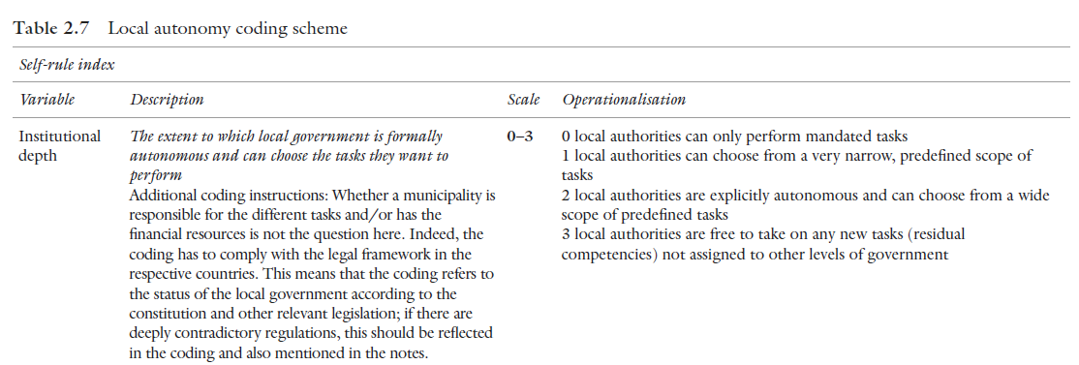
Code Book: Self-rule
Institutional Depth

Slide 29
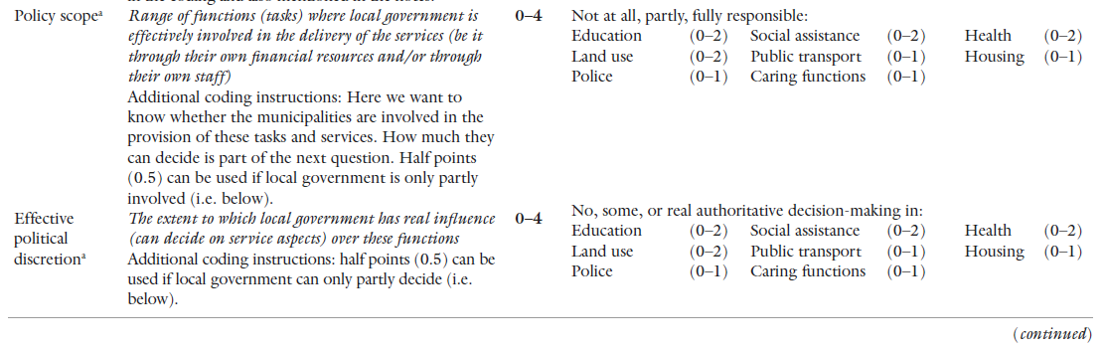
Policy Scope and Effective Political Discretion

Slide 30
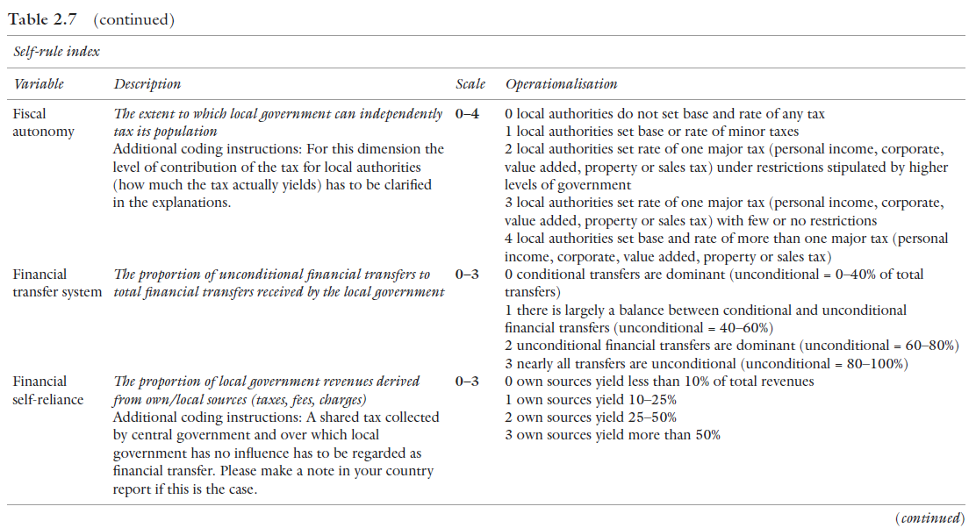
Fiscal autonomy, financial transfer system and Financial self-reliance

Slide 31
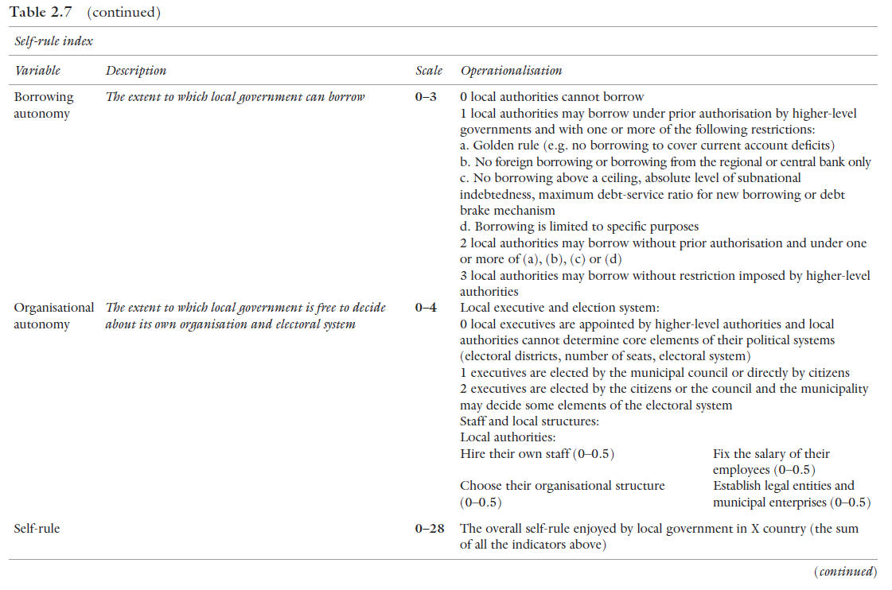
Borrowing autonomy and Organisational autonomy

Slide 32
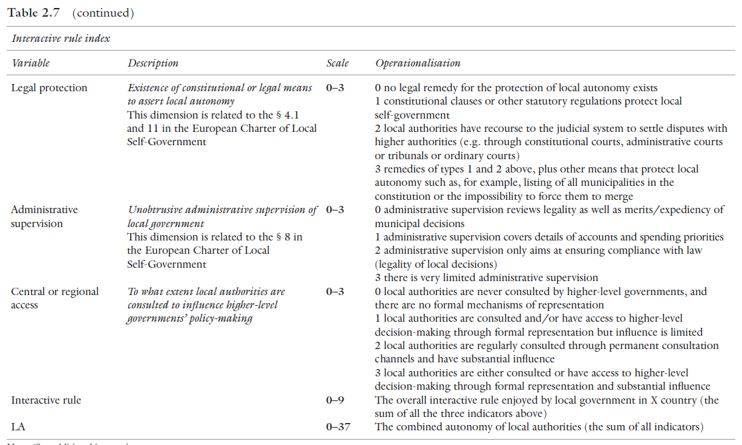
Interactive rule: Legal protection, Administrative supervision and central or regional access

Slide 33
Methodology
Assessment by experts: country experts supervised by 6 country group coordinators who are among the leading scholars in the field
Scores assigned on the basis of a codebook of 11 variables (Ladner, Keuffer & Baldersheim 2016)
Country profiles and datasets
Consistency of the coding controlled in 3 steps
Municipalities as unit of analysis but countries as unit of presentation and weighting by population in case of asymmetry (weighting rules)

Slide 34
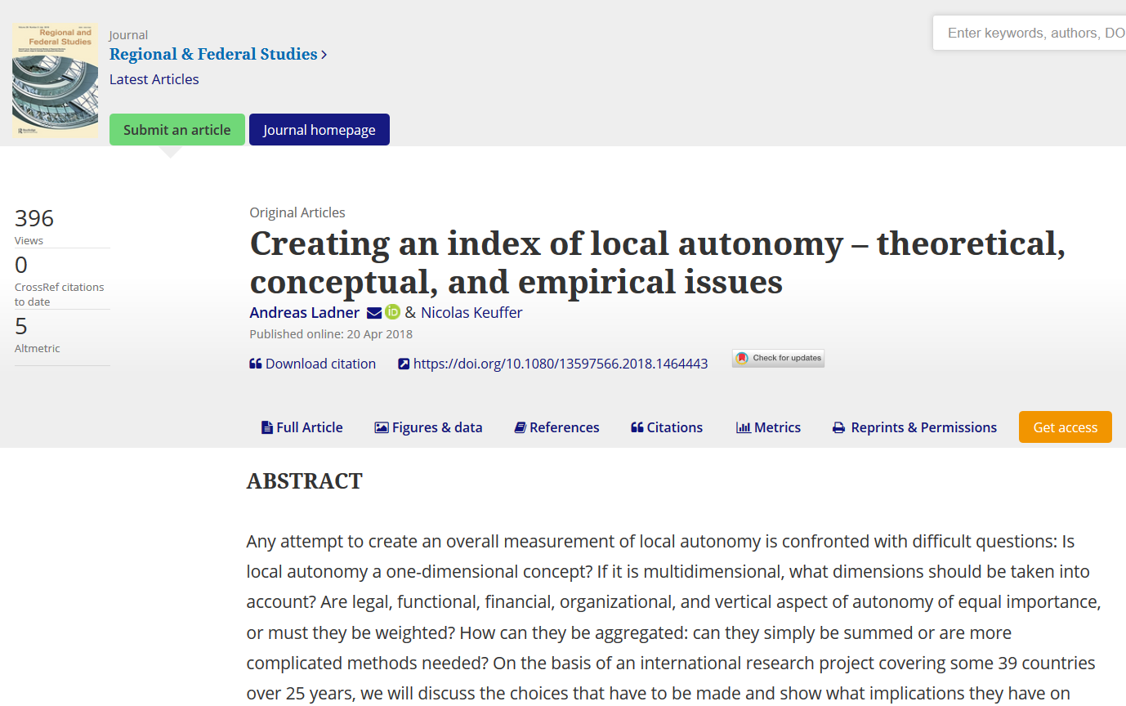
Creating an Index of Local Autonomy

Slide 35
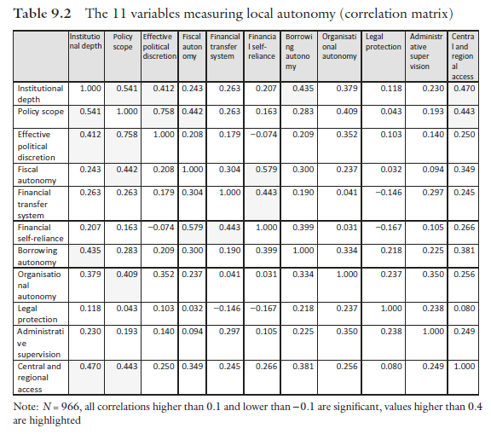

Slide 36
Defining and Measuring LA
Subsequently, 7 dimensions of LA have been theoretically and empirically identified and operationalized
  1) Legal autonomy 2) Political discretion
  3) Policy scope 4) Financial autonomy
  5) Organizational autonomy 6) Non-interference
  7) Access (to senior levels)
  (Keuffer 2016; Ladner et al. 2019)

Slide 37
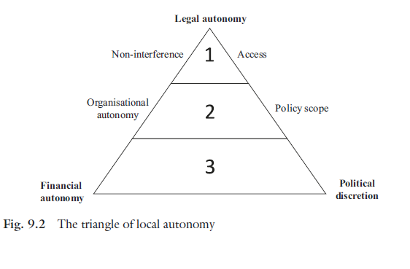
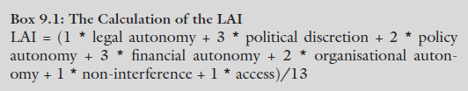
Weighting

Slide 38
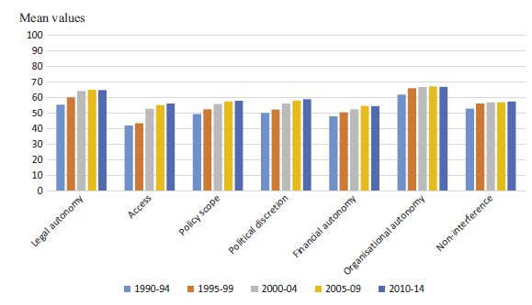

Slide 39
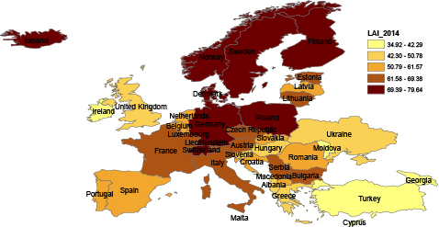
Local Autonomy in Europe (2014)
http://local-autonomy.andreasladner.ch

Slide 40
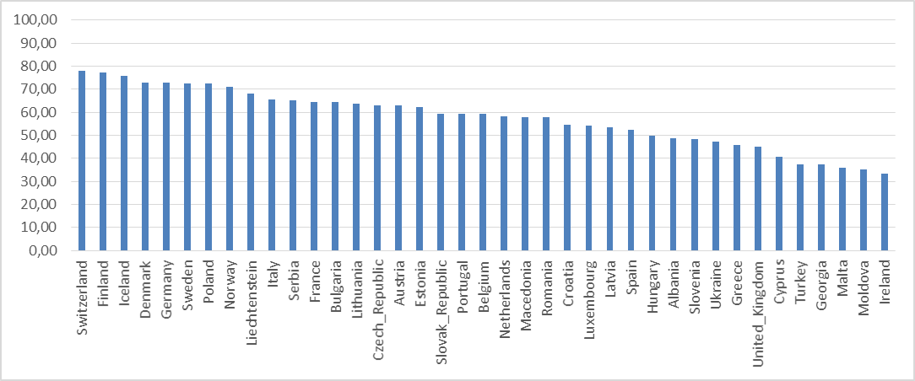
«Country Ranking 2014»

Slide 41
Development of LA in Europe
A general increase and a great diversity among countries

Slide 42
National Patterns of LA
Sources: LAI 2014

Slide 43
Patterns of LA
Country classification of 9 different types of LA, based on the two cornerstones of local autonomy, PD and FA
 |  | Political discretion (PD)
 |  | Low | Medium | High
Financial autonomy (FA) | Low | Type IX (“tutelle”) Georgia, Malta, Moldova, Turkey, United Kingdom | Type VIII Albania, Hungary, Ukraine | Type V (chained democracy) Czech R., Estonia, Latvia, Lithuania, Netherlands, Romania, Slovenia
 | Medium | Type VII Greece | Type III Croatia, Poland, Serbia, Slovakia | Type IV Bulgaria, Macedonia, Portugal
 | High | Type VI (guided democracy) Cyprus, Ireland, Liechtenstein, Spain | Type II Austria, Belgium, France, Italy, Switzerland | Type I (partnership) Denmark, Finland, Germany, Iceland, Luxembourg, Norway, Sweden
Ladner et al. (2019)

Slide 44
And …
Causes
Local Autonomy
Consequences

Slide 45
Does local autonomy …
… lead to economic welfare?
… less corruption?
… more trust?
…. more happyness?
… democracy?

Slide 46
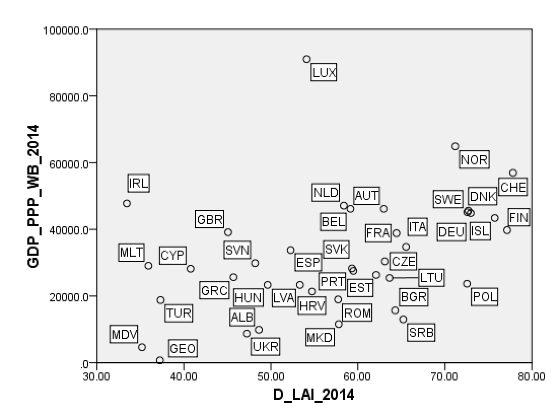
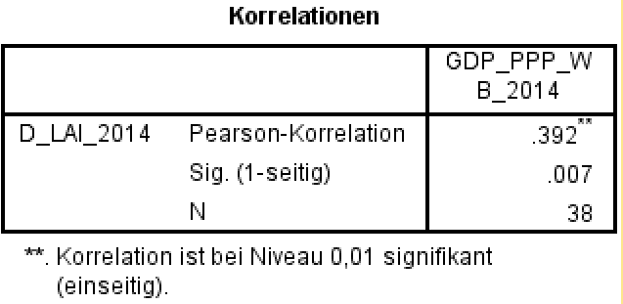
Local autonomy and GDP_PPP

Slide 47
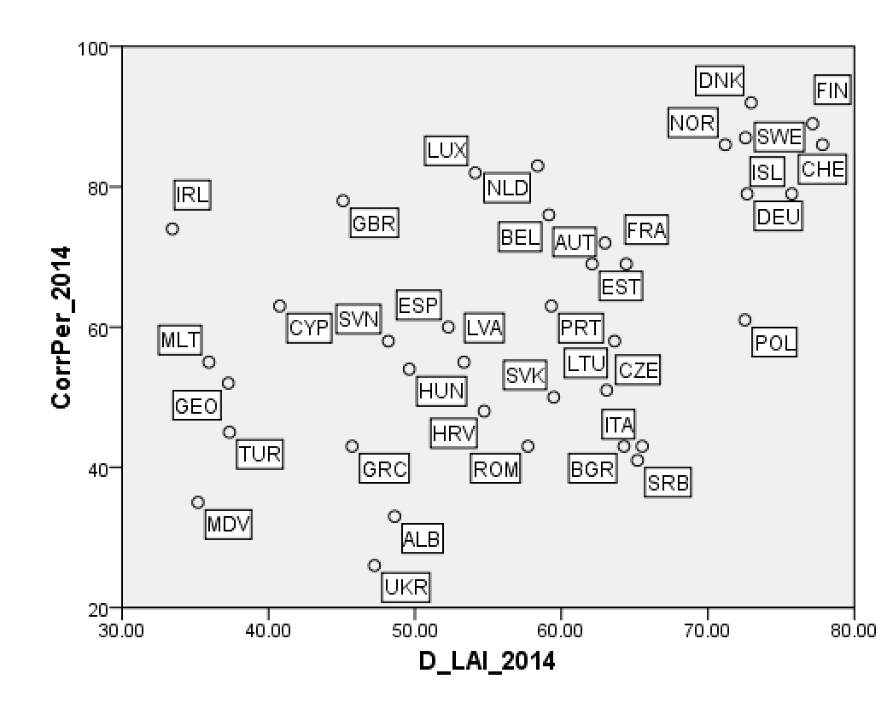
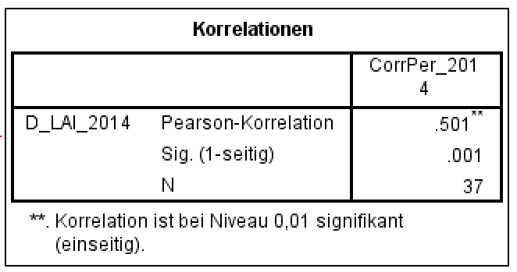
Local autonomy and corruption

Slide 48
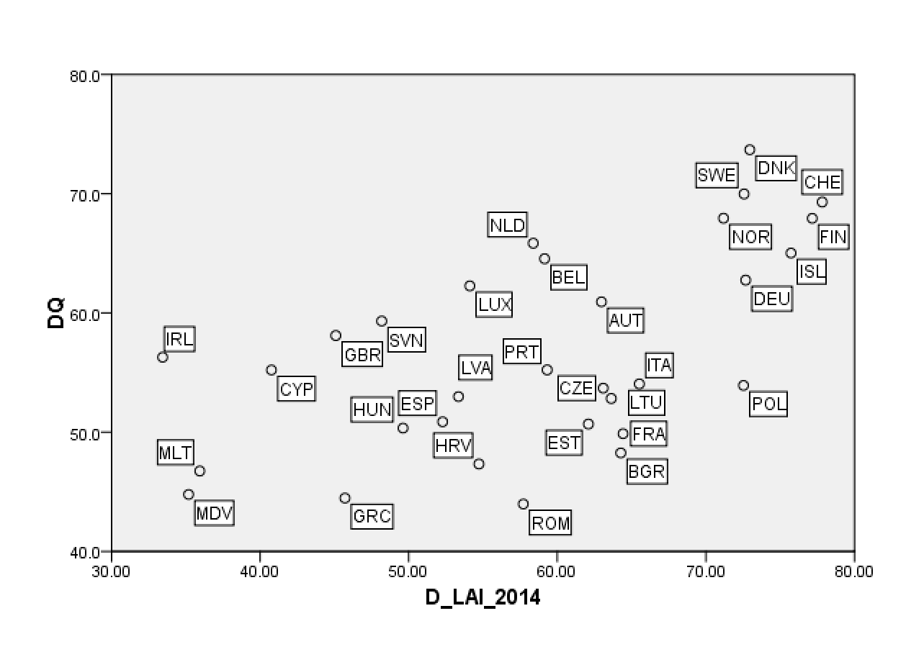
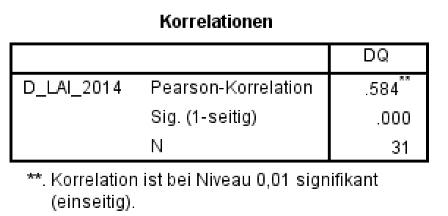
Local autonomy and democracy

Slide 49
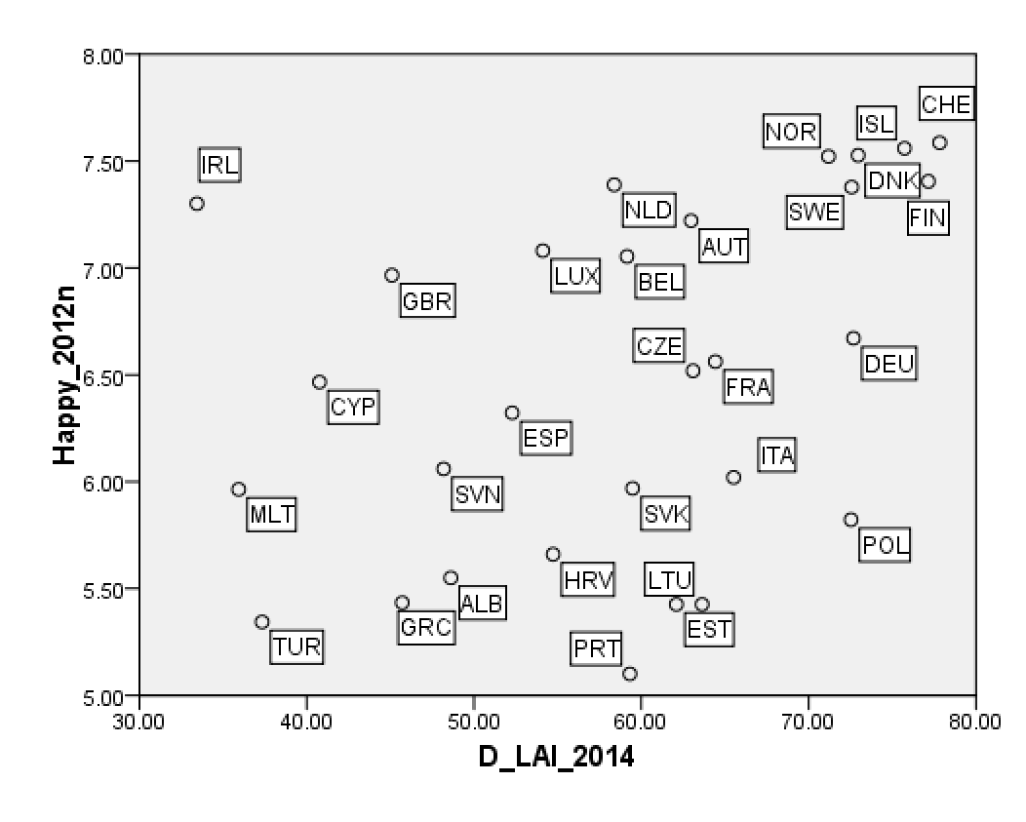
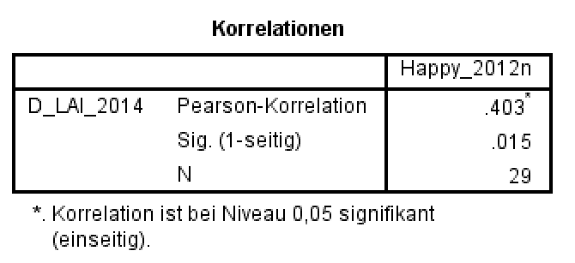
Local autonomy and happyness

Slide 50
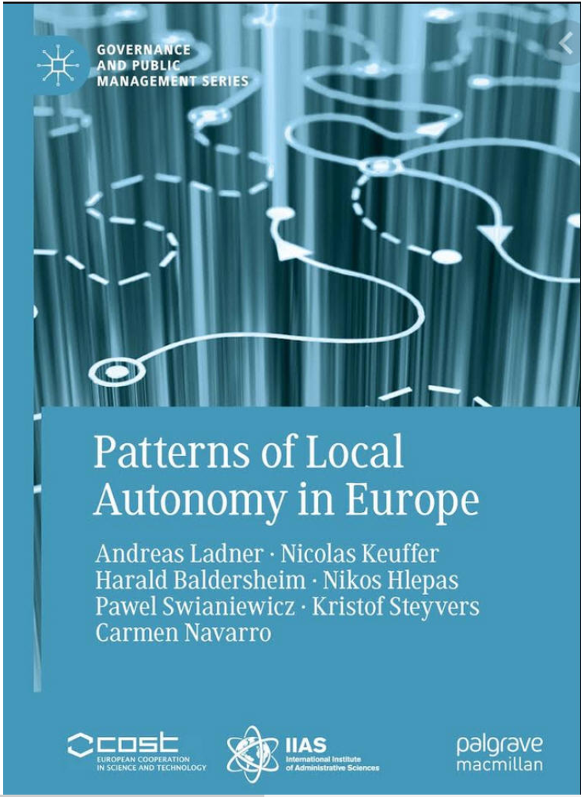
Quite a few publications
Ladner, Andreas & Nicolas Keuffer (2018). Creating an index of local autonomy – theoretical, conceptual, and empirical issues, Regional & Federal Studies, DOI: 10.1080/13597566.2018.1464443.
Ladner, Andreas, Nicolas Keuffer and Harald Baldersheim (2016). "Measuring Local Autonomy in 39 Countries (1990-2014)", Regional and Federal Studies, Volume 26, Issue 3, pp. 321-357. DOI: 10.1080/13597566.2016.1214911.

Slide 51
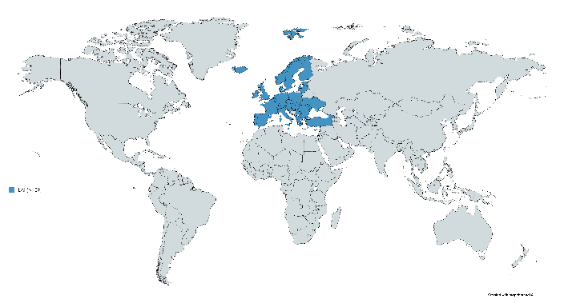
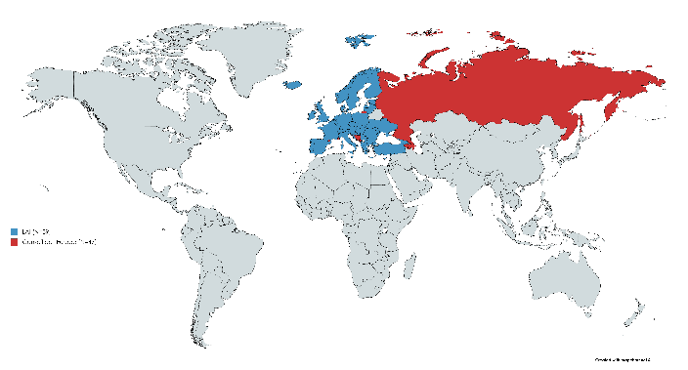
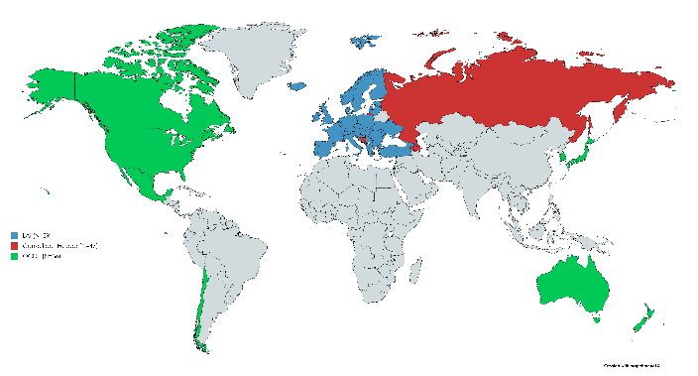
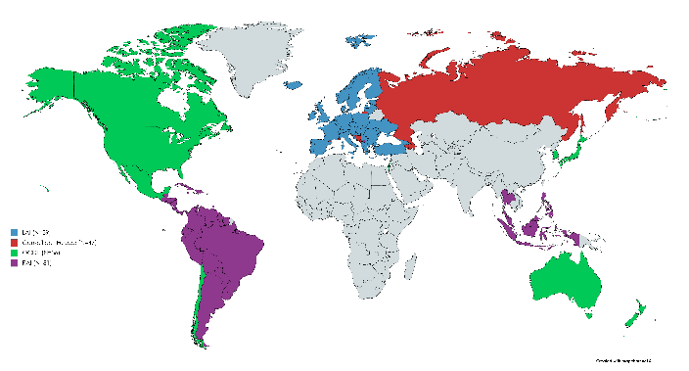
Conclusions and Perspectives
The value, results and data of the LAI project are already recognised
  By the policy-makers and international organisations (e.g. OECD 2019)
  By the academic scholars (e.g. Harguindeguy et al. 2018)
Combination of the LAI and the RAI to better assess MLG
Make greater use of the data collected (e.g. at non-aggregated level)
Complement the macro top-down indicators by a qualitative bottom-up approach of local autonomy/governance (Keuffer & Horber-Papazian 2019)
Specific adjustments and upgrade in the Nordic countries (2014-2019)
LAI 2.0 project: temporal (2014-2020)
and geographical upgrade…

Slide 52

LAI 2.0
Jan Bruegel

Slide 53
Problems
New countries
New questions
Better questions/better coding
Looking backwards

Slide 54
No changes for
Institutional depth
Fiscal autonomy
Financial transfer system
Financial self-reliance
Borrowing autonomy (hardly any)
Administrative supervision

Slide 55
Policy Scope and Effective Political Discretion
Changes in the scores by fields of services
The additional coding instructions by fields of services are radically different (both in the services by field and in the coding scheme)

Slide 56
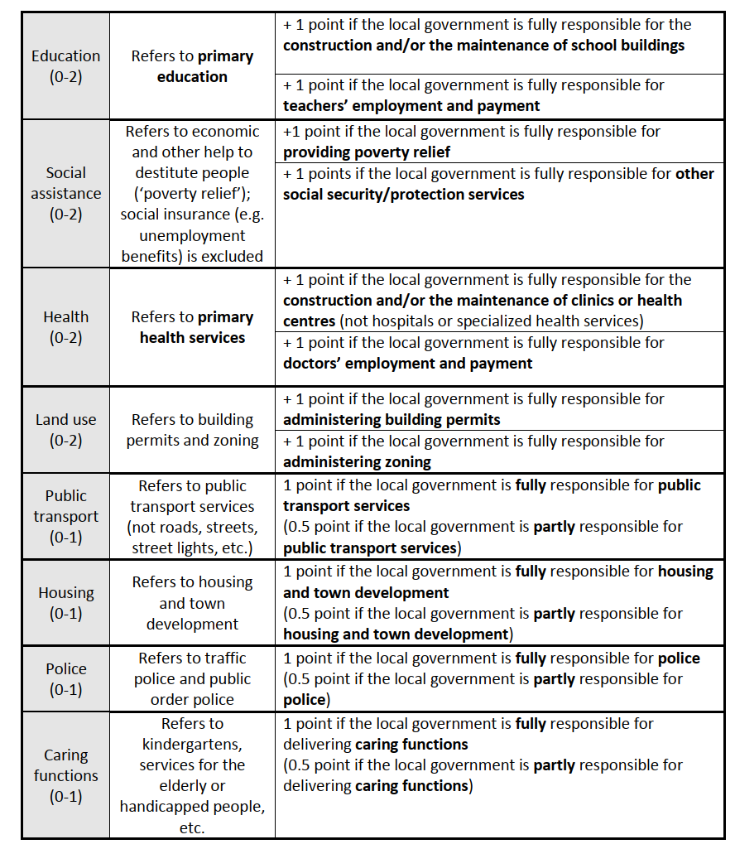
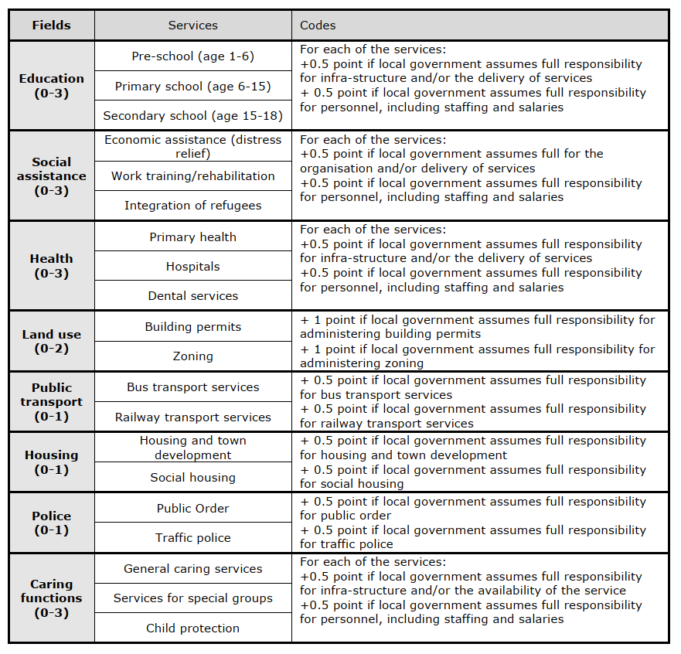
Policy Scope

Slide 57
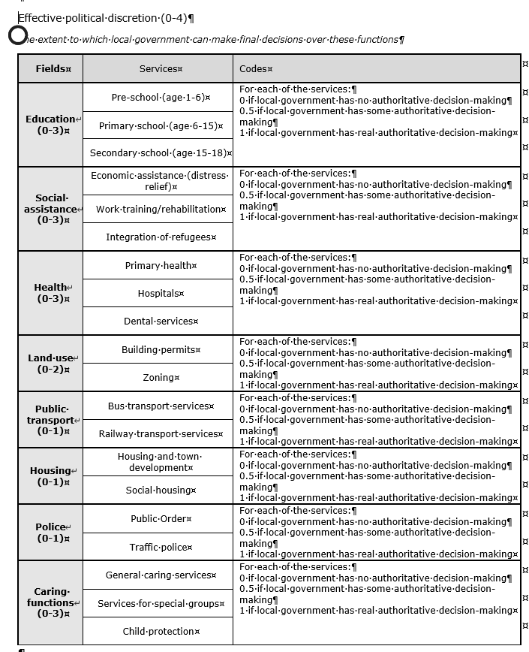
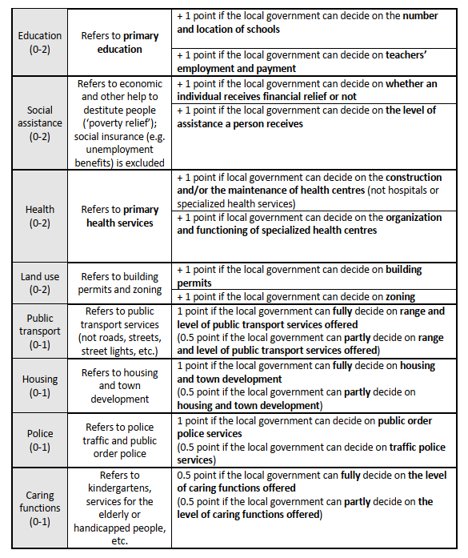
Effective Political Discretion

Slide 58

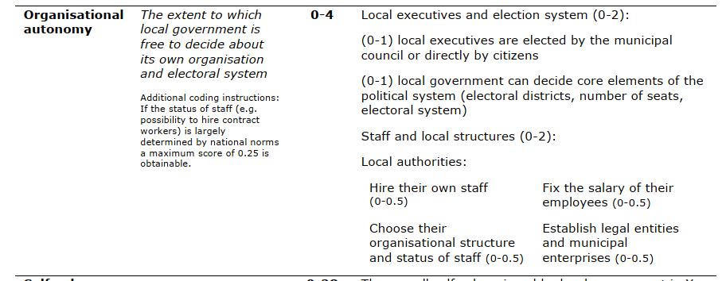
Organisational Autonomy

Slide 59
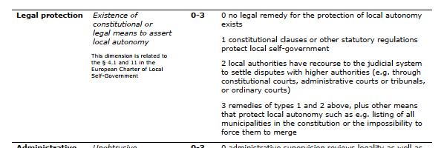
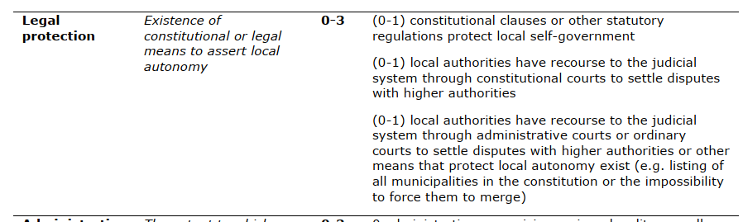
Legal protection

Slide 60
Change or coding?

Slide 61


Finland: From 2 to 3

Slide 62
Interactive rule

Slide 63
2010-2014 – 2015-2020 (absolute differences)

Slide 64

7 Dimensions

Slide 65


Slide 66

New countries LAI 2.0 (means 2015-2020)

Slide 67

LAI 1.0 und 2.0 (2010-14 and 2015-2020)

Slide 68


Slide 69

Additional questions (1)

Slide 70


Additional questions

Slide 71



Slide 72
Additional problems
Asymmetric solutions (Cities and rural areas)
Federalist countries (Switzerland, Germany, Russia, etc.)

Slide 73


26 cantons and 2172 municipalities

Slide 74
Characteristics
Public bodies appointed by the public law of the cantons
Largely autonomous: municipalities can choose an appropriate structure, levy taxes, and independently perform tasks
2324 (1.1.2015) municipalities in 26 cantons. Median: about 1000 residents, Mean: about 2800 residents (Corippo: less than 20, Zurich: 400’000)
Origin of municipalities between the 14th and 19th century
1874: All citizens have the same rights in all municipalities
1998: First mentionning of municipalities in the Swiss Constitution (Art. 50)

Slide 75

Autonomy and diversity instead of equality of living conditions
Quelle: Stalder, Kurt (1999). Föderalismus und Finanzausgleich. Schriftenreihe der Fachgruppe für kantonale Finanzfragen. Solothurn: Verlag FkF.

Slide 76
Confederation, cantons and municipalities: the three levels of the state
Revenue, expenditures and transfers

Slide 77
22.0 mrd.
2014/2013
National gov.
rev.: 64.9 mrd.
exp.: 64.7 mrd.
National tasks:
defense, IR, social security
_____
Cantonal tasks:
education, health, police
_____
Local tasks
primary school,
social assistance, land use, water, waste etc.
29 mrd.
TVA
Income Tax
18.3 mrd.
24.7 mrd.
Cantonal govs.
rev.: 82.7 mrd.
exp.: 85.0 mrd.
42.3 mrd.
74.1 mrd.
3 mrd.
26.0 mrd.
Local govs.
rev.: 45.5 mrd.
exp.: 46.1 mrd.
37.3 mrd.
Citizens
1 Mrd.= 1’000’000’000
Social Security not included (59.8 mrd.)
Health systems only partly included

Slide 78
Tasks of Swiss municipalities
Education: kindergarten, primary school, secondary school
Social welfare and health
Water, electricity, and traffic
Planning and construction, sport and culture
Municipal police (fire, roads, and commerce)
Naturalisation (“swiss maker”)
Internal organization, financial managemet
Execution of higher level tasks

Slide 79
The three components of a public tasks
Deciding/regulating
Doing/executing
Paying/Funding
Who/which level does what?

Slide 80
Central-local relations: problems
«Who pays the fiddler, calls the tune»
Principal-agent problem
Executing and funding without deciding is not very satisfying

Slide 81
How are the different tasks and rolls allocated to the different levels?
Principle of subsidiarity & principle of fiscal equivalence!

Slide 82

Different forms of «cooperation»
National level
Cantonal level
Dual Federalism
Cooperative Federalism

Slide 83

Multi-level governance

Slide 84
Enquêtes auprès des secrétaires communaux (1988, 1994, 1998 et 2005, 2009)

Slide 85

Autonomie selon la taille de la commune
Communes comparables, N= 741

Slide 86

Questions and Discussion
Thank you for your attention!
andreas.ladner@unil.ch

Slide 87
A codebook inspired to some extent by the RAI
RAI | LAI
SELF-RULE | SELF-RULE
tier_instdepth 0-3 The extent to which a regional government is autonomous rather than deconcentrated: 0: no functioning general-purpose administration at regional level 1: deconcentrated, general-purpose, administration 2: non-deconcentrated, general–purpose, administration subject to central government veto 3: non-deconcentrated, general–purpose, administration *not* subject to central government veto. | Institutional depth (0-3): The extent to which local government is formally autonomous and can choose which tasks to perform 0 local authorities can only perform mandated tasks 1 local authorities can choose from a very narrow, predefined scope of tasks 2 local authorities are explicitly autonomous and can choose from a wide scope of predefined tasks 3 local authorities are free to take on any new tasks (residual competencies) not assigned to other levels of government Conceptually related to RAI but different operationalisation
tier_policy 0-4 The range of policies for which a regional government is responsible: 0: very weak authoritative competence in a), b), c), d) whereby a) economic policy; b) cultural-educational policy; c) welfare policy; d) one of the following: residual powers, police, own institutional set–up, local government 1: authoritative competencies in one of a), b), c) or d) 2: authoritative competencies in at least two of a), b), c), or d) 3: authoritative competencies in d) and at least two of a), b), or c) 4: criteria for 3 plus authority over immigration or citizenship. | Policy scope (0-4): Range of functions (tasks) where local government is effectively involved in the delivery of the services (be it through their own financial resources and/or through their own staff) Not at all; partly; fully responsible for: Education (0-2), Social assistance (0-2), Health (0-2), Land-use (0-2), Public transport (0-1), Housing (0-1), Police (0-1), Caring functions (0-1) Conceptually related but different coding

Slide 88
SELF-RULE (NEXT) | SELF-RULE (NEXT)
Not included in the RAI | Effective political discretion (0-4): The extent to which local government has real influence (can decide on service aspects) over these functions No, some, or real authoritative decision-making in: Education (0-2), Social assistance (0-2), Health (0-2), Land-use (0-2), Public transport (0-1), Housing (0-1), Police (0-1), Caring functions (0-1)
tier_fiscauto 0-4 The extent to which a regional government can independently tax its population: 0: central government sets base and rate of all regional taxes 1: regional government sets the rate of minor taxes 2: regional government sets base and rate of minor taxes 3: regional government sets the rate of at least one major tax: personal income, corporate, value added, or sales tax 4: regional government sets base and rate of at least one major tax. | Fiscal autonomy (0-4): The extent to which local government can independently tax its population Same coding
tier_borrowauto 0-3 The extent to which a regional government can borrow: 0: the regional government does not borrow (e.g. centrally imposed rules prohibit borrowing) 1: the regional government may borrow under prior authorization (ex ante) by the central government and with one or more of the following centrally imposed restrictions: a. golden rule (e.g. no borrowing to cover current account deficits) b. no foreign borrowing or borrowing from the central bank c. no borrowing above a ceiling d. borrowing is limited to specific purposes 2: the regional government may borrow without prior authorization (ex post) and under one or more of a), b), c), d), e) 3: the regional government may borrow without centrally imposed restrictions. | Borrowing autonomy (0-3): The extent to which local government can borrow Same coding

Slide 89
SELF-RULE (NEXT) | SELF-RULE (NEXT)
Not included in the RAI | Financial transfer system (0-3): The proportion of unconditional financial transfers to total financial transfers received by the local government 0 conditional transfers are dominant (unconditional = 0-40% of total transfers) 1 there is largely a balance between conditional and unconditional financial transfers (unconditional = 40-60%) 2 unconditional financial transfers are dominant (unconditional = 60-80%) 3 nearly all transfers are unconditional (unconditional = 80-100%)
Not included in the RAI | Financial self-reliance (0-4): The proportion of local government revenues derived from own/local sources (taxes, fees, charges) 0 own sources yield less than 10% of total revenues 1 own sources yield 10-25% 2 own sources yield 25-50% 3 own sources yield more than 50%
tier_rep 0-4 The extent to which a region has an independent legislature and executive, which is the sum of assembly and executive. Assembly: 0: no regional assembly 1: indirectly elected assembly 2: directly elected assembly Executive: 0: regional executive appointed by central government 1: dual executive appointed by central government and regional assembly 2: regional executive is appointed by regional assembly or directly elected | Organisational autonomy (0-4): The extent to which local government is free to decide about its own organisation and electoral system Local Executive and election system: 0 local executives are appointed by higher-level authorities and local authorities cannot determine core elements of their political systems (electoral districts, number of seats, electoral system) 1 executives are elected by the municipal council or directly by citizens 2 executives are elected by the citizens or the council and the municipality may decide some elements of the electoral system Staff and local structures: Local authorities: Hire their own staff (0-0.5); Fix the salary of their employees (0-0.5); Choose their organisational structure (0-0.5); Establish legal entities and municipal enterprises (0-0.5) Conceptually related but different operationalisation and coding

Slide 90
RAI | LAI
SHARED-RULE | INTERACTIVE-RULE
tier_lawmaking 0-2 The extent to which regional representatives co–determine national legislation, which is the sum of law_a to law_f. 0.5 regions are units of rep in national legislature 0.5 regional government designate representatives in national legislature 0.5 regions have majority representation national legislature based on regional representation 0.5 the legislature based on regional representation has extensive legislative authority | Legal protection (0-3): Existence of constitutional or legal means to assert local autonomy 0 no legal remedy for the protection of local autonomy exists 1 constitutional clauses or other statutory regulations protect local self-government 2 local authorities have recourse to the judicial system to settle disputes with higher authorities (e.g. through constitutional courts, administrative courts or tribunals, or ordinary courts) 3 remedies of types 1 and 2 above, plus other means that protect local autonomy such as e.g. listing of all municipalities in the constitution or the impossibility to force them to merge Indirectly related to RAI through focus on legal processes of influence open to LG, but different since RAI item is about formal participation in law-making
Not included in the RAI | Administrative supervision (0-3): Unobtrusive administrative supervision of local government 0 administrative supervision reviews legality as well as merits/expediency of municipal decisions 1 administrative supervision covers details of accounts and spending priorities 2 administrative supervision only aims at ensuring compliance with law (legality of local decisions) 3 there is very limited administrative supervision
tier_executive control 0-2 The extent to which a regional government co–determines national policy in intergovernmental meetings, which is the maximum value of execcon_multi (lateral) and execcon_bi (lateral). 0 no routine meetings between central and regional government to negotiate policy 1 routine meetings between central and regional government without legally binding authority | Central or regional access (0-3): the extent to which local authorities are consulted to influence higher level governments’ policy-making 0 local authorities are never consulted by higher level governments and there are no formal mechanisms of representation 1 local authorities are consulted and/or have access to higher-level decision-making through formal representation but influence is limited

Slide 91
SHARED-RULE (NEXT) | INTERACTIVE-RULE (NEXT)
2 routine meetings between central and regional government with legally binding authority | 2 local authorities are regularly consulted through permanent consultation channels and have substantial influence 3 local authorities are either consulted or have access to higher-level decision-making through formal representation; and substantial influence Conceptually related but different operationalisation
tier_fiscal control 0-2 | Not included in the LAI
tier_borrowing control 0-2 | Not included in the LAI
tier_constitutional reform 0-4 | Not included in the LAI
tier_selfrule 0-18 The authority exercised by a regional government over those who live in the region, which is the sum of tier_instdepth, tier_policy, tier_fiscauto, tier_borrowauto, and tier_rep. | Self-rule (0-28): The sum of the above indices pertaining to self-rule, i.e. institutional depth, policy scope, effective political discretion, fiscal autonomy, financial transfer system, financial self-reliance, borrowing autonomy, and organisational autonomy
tier_sharedrule 0-12 The authority exercised by a regional government or its representatives in the country as a whole, which is the sum of tier_lawmaking, tier_execcon, tier_fisccon, tier_borrowcon, and tier_constit. | Interactive rule (0-9): The sum of the above indices pertaining to interactive rule, i.e. legal protection, administrative supervision, and central or regional access
tier_RAI 0-27 Regional authority index, which is the sum of tier_selfrule and tier_shared rule. | Local autonomy (0-37): The sum of self-rule and interactive rule
Source: Codebook Regional Authority Index (RAI)
Regional Scores Dataset version July 2015, http://www.arjanschakel.nl/data/RAI_region_scores_2015_codebook.pdf
See also: Hooghe, Liesbet, Gary Marks, Arjan H. Schakel, Sandra Chapman Osterkatz, Sara Niedzwiecki, Sarah Shair-Rosenfield (2016), A Postfunctionalist Theory of Governance. Volume I: Measuring Regional Authority, Oxford: Oxford University Press.
Source: Codebook Local Autonomy Index (LAI)
Ladner, Andreas, Nicolas Keuffer, Harald Baldersheim (2015), Local autonomy Index for European countries (1990–2014). Release 1.0., Brussels: European Commission.
http://ec.europa.eu/regional_policy/en/information/publications/studies/2015/self-rule-index-for-local-authorities-release-1-0
See also: Ladner, Andreas, Nicolas Keuffer, Harald Baldersheim (2016), "Measuring Local Autonomy in 39 Countries (1990–2014)", Regional & Federal Studies, Vol. 26 No. 3, pp. 321-357.

Slide 92
Appendix II) Ranking LAI 2014 and changes between 1990 and 2014
Countries | LAI_2014 | LAI_1990 | Changes |  | Countries (next) | LAI_2014 | LAI_1990 | Changes
Switzerland | 79.64 | 78.42 | 1.22 |  | Netherlands | 59.56 | 53.55 | 6.01
Finland | 79.36 | 75.19 | 4.17 |  | Macedonia | 59.27 | 33.41 | 25.86
Iceland | 78.09 | 68.37 | 9.72 |  | Romania | 58.14 | 29.26 | 28.88
Sweden | 75.09 | 73.73 | 1.36 |  | Croatia | 56.74 | 40.99 | 15.75
Denmark | 74.65 | 75.76 | -1.11 |  | Luxembourg | 55.90 | 62.63 | -6.73
Poland | 74.11 | 68.54 | 5.57 |  | Spain | 54.98 | 60.57 | -5.59
Germany | 73.93 | 73.54 | 0.39 |  | Latvia | 54.29 | 51.34 | 2.95
Norway | 73.92 | 65.13 | 8.79 |  | Hungary | 50.78 | 62.84 | -12.07
Liechtenstein | 69.38 | 72.68 | -3.30 |  | Albania | 50.63 | 13.46 | 37.17
Italy | 68.18 | 51.10 | 17.08 |  | Slovenia | 48.92 | 23.56 | 25.36
Serbia | 66.99 | 48.37 | 18.62 |  | Greece | 47.88 | 41.45 | 6.43
France | 66.78 | 64.21 | 2.57 |  | Ukraine | 47.66 | 42.41 | 5.25
Bulgaria | 66.23 | 25.32 | 40.91 |  | United Kingdom | 45.65 | 46.83 | -1.18
Lithuania | 65.10 | 47.31 | 17.79 |  | Cyprus | 42.29 | 37.12 | 5.17
Czech Republic | 64.92 | 43.68 | 21.23 |  | Turkey | 39.72 | 40.24 | -0.52
Austria | 64.84 | 63.47 | 1.37 |  | Malta | 39.18 | 30.12 | 9.06
Estonia | 63.66 | 64.46 | -0.80 |  | Georgia | 38.36 | 22.97 | 15.38
Portugal | 61.57 | 51.81 | 9.76 |  | Moldova | 35.87 | 16.48 | 19.39
Belgium | 61.33 | 51.89 | 9.44 |  | Ireland | 34.92 | 30.44 | 4.49
Slovakia | 60.85 | 44.01 | 16.84
Notes: Sorted by 2014; For Albania, Latvia, Malta, Romania and Ukraine there is no data for 1990; The first years of measurement are: 1992, 1991, 1993, 1992 and 1991.

Slide 93
Appendix III) Ranking LAI 2014 – Seven constitutive dimensions
Countries | LA_2014 | AC_2014 | PS_2014 | PD_2014 | FA_2014 | OA_2014 | NI_2014 |  | Countries (next) | LA_2014 | AC_2014 | PS_2014 | PD_2014 | FA_2014 | OA_2014 | NI_2014
Albania | 66.67 | 33.33 | 54.17 | 50.00 | 41.67 | 62.50 | 33.33 |  | Lithuania | 66.67 | 100.00 | 70.83 | 76.67 | 33.33 | 75.00 | 50.00
Austria | 66.67 | 100.00 | 65.76 | 53.33 | 69.62 | 51.39 | 66.67 |  | Luxembourg | 66.67 | 33.33 | 50.00 | 63.33 | 66.67 | 25.00 | 83.33
Belgium | 66.67 | 52.50 | 54.17 | 56.67 | 70.83 | 75.00 | 20.27 |  | Macedonia | 66.67 | 33.33 | 58.33 | 66.67 | 54.17 | 75.00 | 33.33
Bulgaria | 100.00 | 66.67 | 79.17 | 66.67 | 45.83 | 75.00 | 33.33 |  | Malta | 66.67 | 100.00 | 12.50 | 23.33 | 29.17 | 25.00 | 83.33
Croatia | 33.33 | 33.33 | 56.93 | 61.80 | 49.48 | 75.00 | 61.80 |  | Moldova | 33.33 | 33.33 | 33.33 | 46.67 | 29.17 | 50.00 | 0.00
Cyprus | 66.67 | 33.33 | 22.12 | 24.36 | 62.34 | 50.00 | 38.47 |  | Netherlands | 66.67 | 66.67 | 62.50 | 63.33 | 45.83 | 75.00 | 33.33
Czech Republic | 100.00 | 33.33 | 45.83 | 76.67 | 37.50 | 100.00 | 66.67 |  | Norway | 0.00 | 66.67 | 91.67 | 66.67 | 70.83 | 100.00 | 83.33
Denmark | 33.33 | 66.67 | 87.50 | 70.00 | 66.67 | 100.00 | 83.33 |  | Poland | 66.67 | 100.00 | 79.06 | 64.33 | 58.33 | 100.00 | 66.67
Estonia | 100.00 | 33.33 | 62.50 | 70.00 | 33.33 | 100.00 | 50.00 |  | Portugal | 66.67 | 66.67 | 54.17 | 63.33 | 58.33 | 50.00 | 83.33
Finland | 66.67 | 66.67 | 79.17 | 83.33 | 83.33 | 75.00 | 83.33 |  | Romania | 100.00 | 33.33 | 66.67 | 70.00 | 41.67 | 62.50 | 33.33
France | 100.00 | 66.67 | 83.05 | 59.77 | 70.83 | 25.00 | 83.33 |  | Serbia | 66.67 | 66.67 | 69.28 | 62.09 | 58.33 | 75.00 | 83.33
Georgia | 66.67 | 33.33 | 45.83 | 43.33 | 29.17 | 25.00 | 33.33 |  | Slovakia | 66.67 | 100.00 | 50.00 | 53.33 | 58.33 | 75.00 | 33.33
Germany | 66.67 | 66.67 | 87.50 | 73.33 | 81.47 | 62.50 | 66.31 |  | Slovenia | 66.67 | 33.33 | 51.43 | 65.62 | 16.67 | 75.00 | 33.33
Greece | 66.67 | 33.33 | 37.50 | 43.33 | 45.83 | 50.00 | 66.67 |  | Spain | 66.67 | 33.33 | 48.68 | 35.61 | 70.83 | 50.00 | 83.33
Hungary | 66.67 | 33.33 | 70.83 | 60.00 | 29.17 | 62.50 | 16.67 |  | Sweden | 33.33 | 66.67 | 75.00 | 73.33 | 87.50 | 75.00 | 83.33
Iceland | 33.33 | 100.00 | 75.00 | 80.00 | 70.83 | 100.00 | 66.67 |  | Switzerland | 93.70 | 99.23 | 69.99 | 50.72 | 98.02 | 100.00 | 47.84
Ireland | 33.33 | 33.33 | 20.83 | 23.33 | 66.67 | 25.00 | 16.67 |  | Turkey | 33.33 | 33.33 | 19.81 | 29.18 | 41.67 | 50.00 | 83.33
Italy | 66.67 | 66.67 | 62.50 | 60.00 | 66.67 | 75.00 | 83.33 |  | Ukraine | 66.67 | 33.33 | 57.69 | 56.41 | 15.38 | 75.00 | 41.03
Latvia | 66.67 | 66.67 | 62.50 | 76.67 | 16.67 | 50.00 | 66.67 |  | United Kingdom | 65.69 | 40.45 | 32.90 | 26.32 | 41.67 | 75.00 | 76.11
Liechtenstein | 100.00 | 33.33 | 45.83 | 50.00 | 87.50 | 100.00 | 66.67
Notes: Sorted by alphabetic order; LA = Legal autonomy, AC = Access, PS = Policy scope, PD = Political discretion, FA = Financial autonomy, OA = Organisational autonomy, NI = Non interference.

Slide 94


Slide 95


Slide 96


Slide 97


Slide 98


Slide 99


Slide 100


Slide 101


