Slide 1
Federalism and Decentralization in Switzerland: from conflict resolution towards political and economic success
1st Middle East Mediterranean Summer Summit (16 ‐ 26 August 2018)
Lugano, 20.8.2018
Prof. Dr. Andreas Ladner, IDHEAP, Université de Lausanne

Slide 2
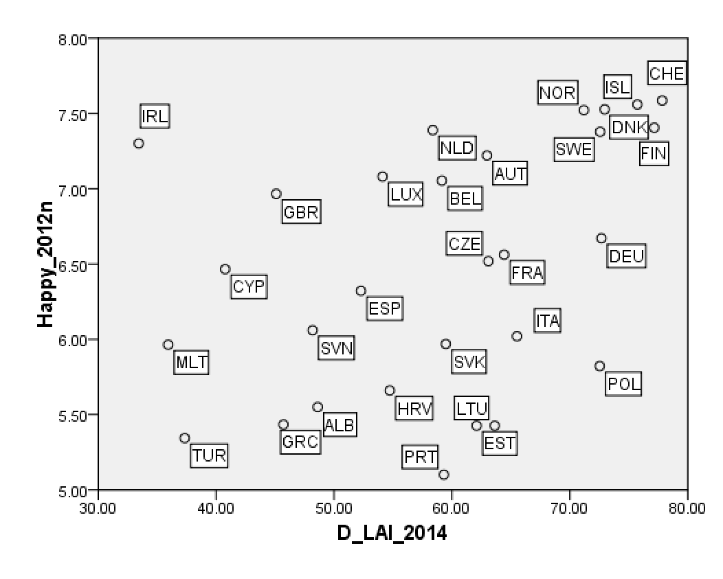
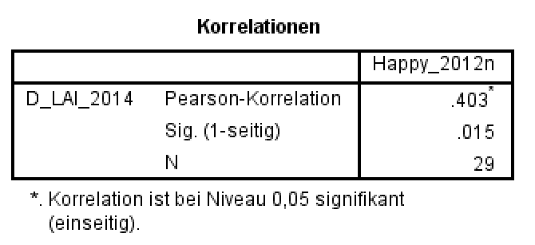
Local autonomy and happyness

Slide 3
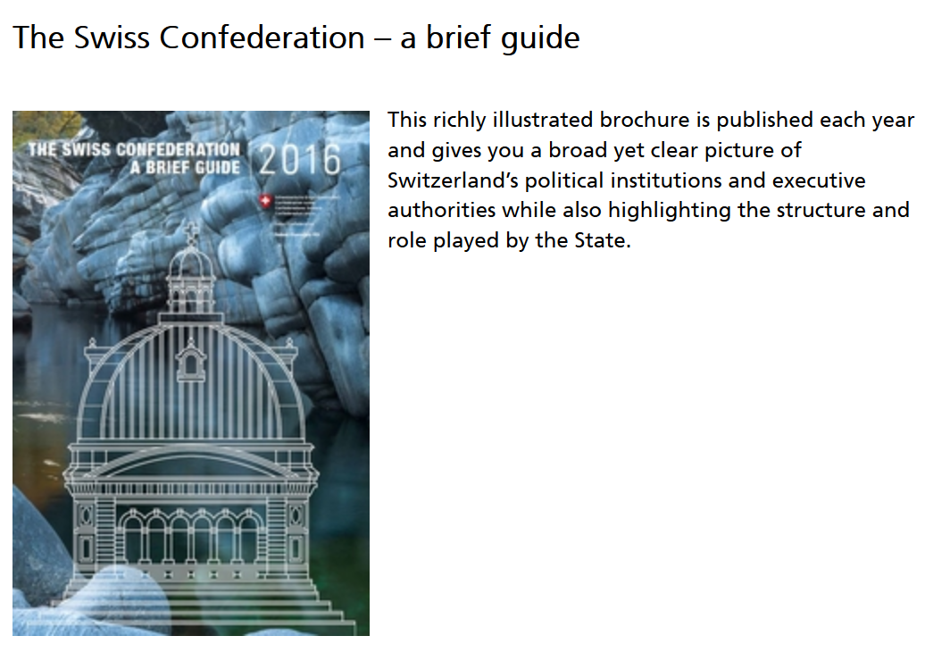





Sources

Slide 4
Topics
Heterogeneous society
Federalism and Decentralisation
Financial Autonomy, Transfers, Equalization, and Direct Democracy

Slide 5
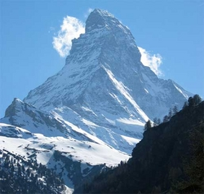
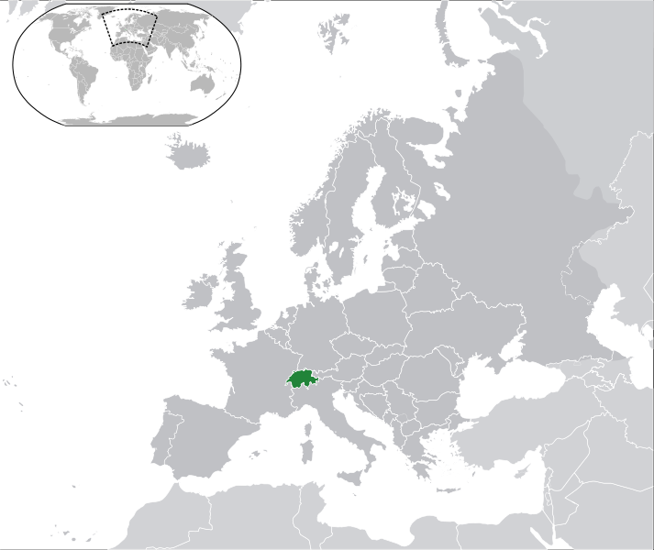
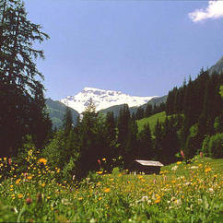
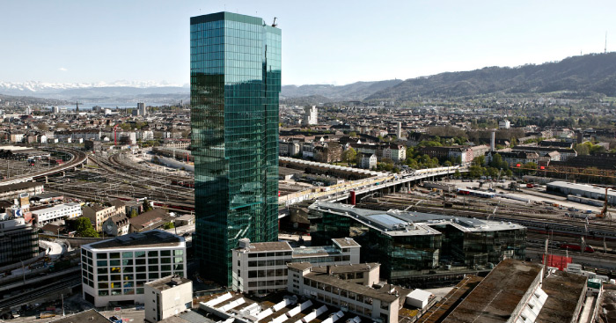
Switzerland (8,370,000 inhabitants)

Slide 6

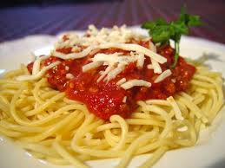
Cultural differences
The „Röschtigraben“
The „Spaghettigraben“

Slide 7
Language areas
Notes:
Source: ofs, Atlas de la Suisse 2005
3 bilingues
1 = BE (5% francophones; 7% latins)
2 = FR, VS (2/3 romands)
3 = GR (4/5 germanophones)

Slide 8
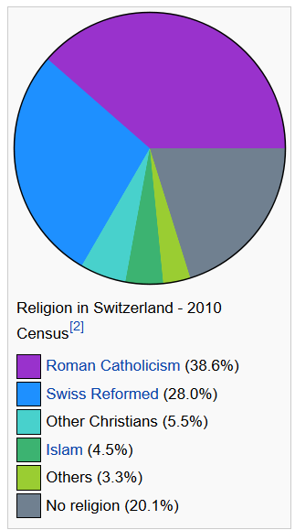
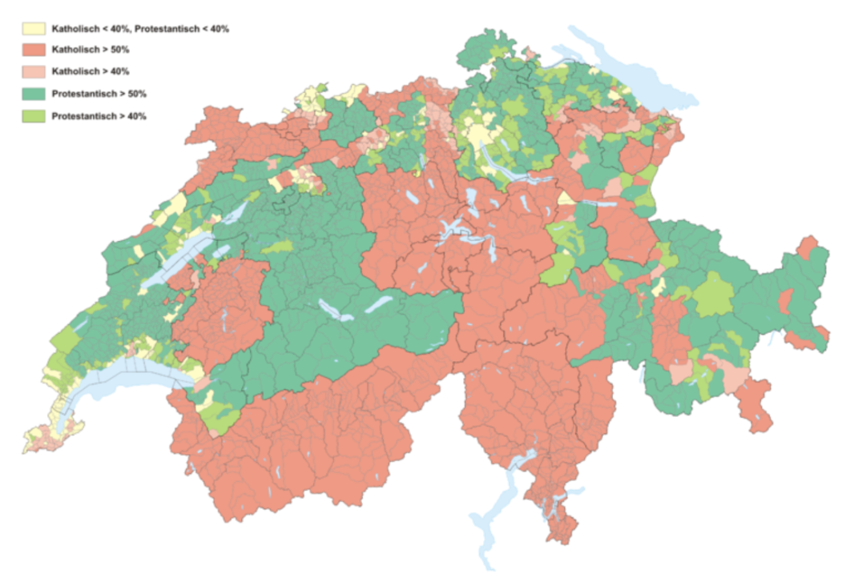
Denominations
http://en.wikipedia.org/wiki/Religion_in_Switzerland

Slide 9
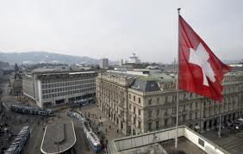
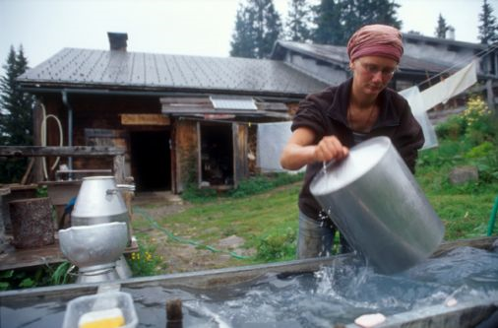
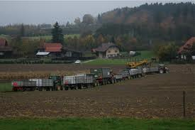

(Economic) Differences
Zürich Paradeplatz (CS, UBS)
Alp Furna (GR)

Slide 10
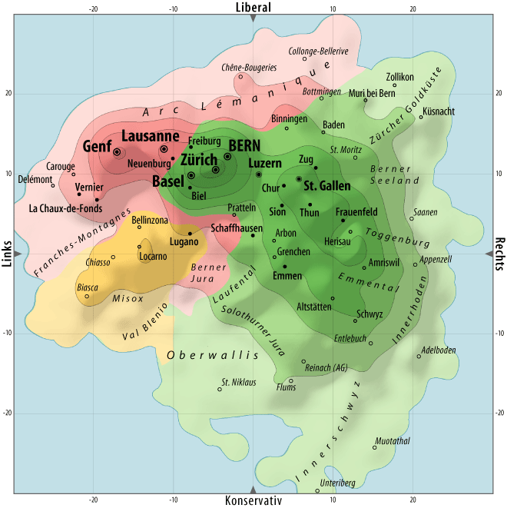
Source: Michael Hermann, Heiri Leutholt, sotomo

Slide 11
Sound political institutions: The three pillars of the Swiss politial system
Policies
Power Sharing!
Consensus Democracy
Direct democracy
Federalism
Society
Notes:
Es geht um Politik, um politische Ideen, wie sie im politischen Intressenvermittlungssystem abgebildet werden und es geht im die wichtigsten Elemente des politischen Systems

Slide 12
And some luck: Cross-cutting Cleavages
French speaking,
Catholics,
poor
F
cath.
rich
poor
prot.
German speaking, protestants, rich
G
cath.
rich
poor
prot.

Slide 13
Topics
Heterogeneous society
Federalism and Decentralisation
Financial Autonomy, Transfers, Equalization, and Direct Democracy

Slide 14
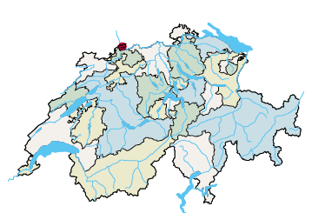
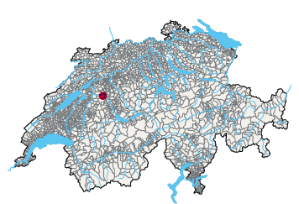
26 cantons (and 2222 municipalities)

Slide 15
Inhabitants (8,2 million)
Quelle: www.badac.ch
Notes:
Vergleich Germann: Grosse Unterschiede zwischen den Kantonen. Zürich: ein sechstel der Schweiz, wirtschaftlich ein Viertel. Ohne Zürich läuft nichts in diesem Staat.
Die Staat Zürich wäre auf Platz 7.
Die Stadt Zürich wäre der siebentgrösste Kanton!
=> vgl. Diskussion Reform des Ständemehrs, Stellung der Städte im Staat

Slide 16
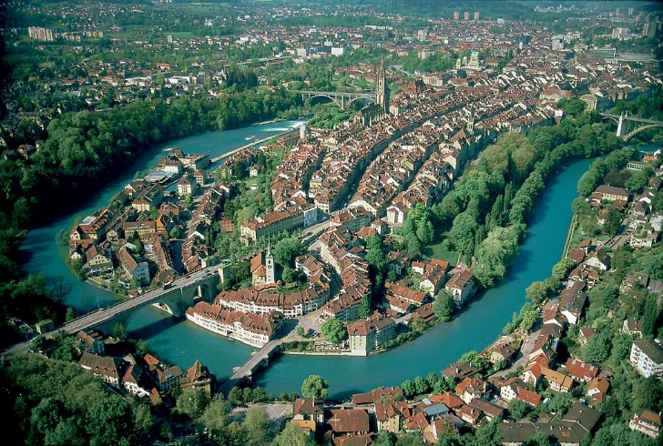
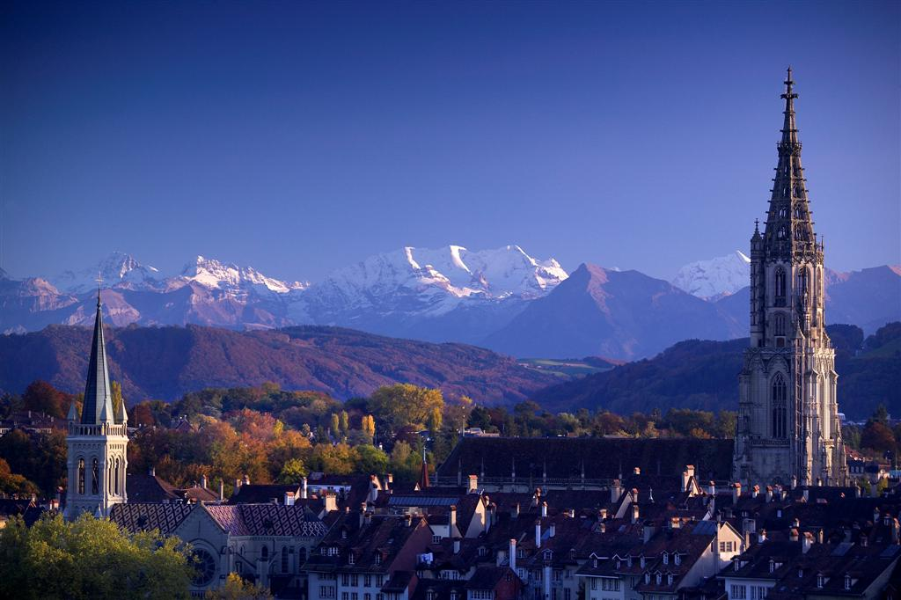
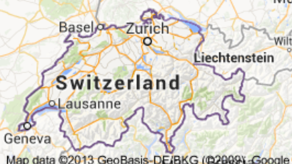
Bern: federal capital, seat of governemnt

Slide 17
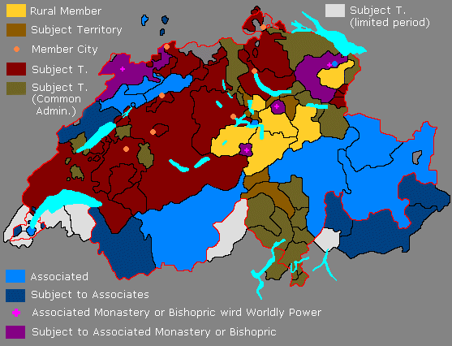
The ancient political system in Switzerland
Source: http://history-switzerland.geschichte-schweiz.ch/swiss-revolution-helvetic-republic-1798.html

Slide 18
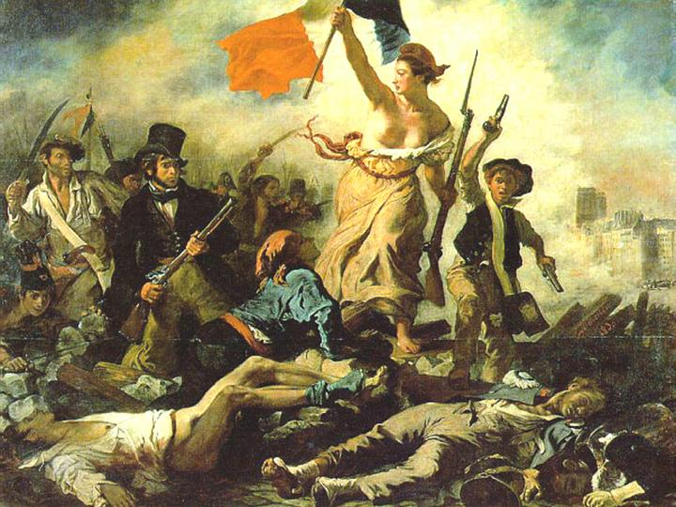
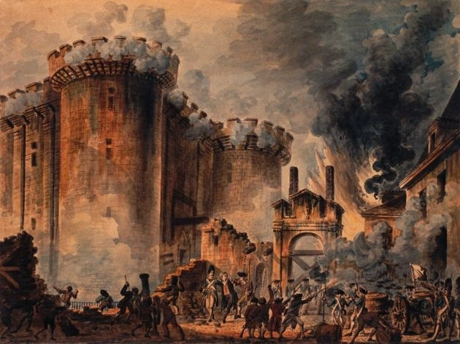
French Revolution (1789)
The Storming of the Bastille, July 14, 1789

Slide 19
The Helvetic Republic (1798-1803)
On 5 March 1798, French troops completely overran Switzerland.The Old Swiss Confederation collapsed.
On 12 April 1798 the Helvetic Republic was proclaimed: "One and Indivisible".
The new régime abolished cantonal sovereignty and feudal rights. The occupying forces established a centralised state based on the ideas of the French Revolution.

Slide 20
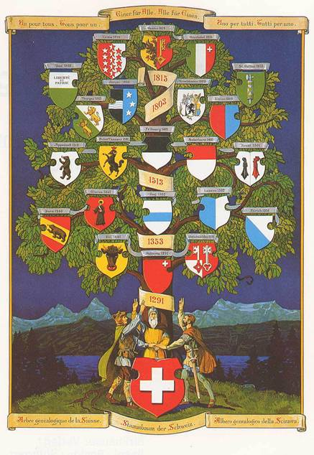
1803: Restoration of the old Confederation of the 13 Cantons
+ 6 new Cantons (SG, GR, AG, TG, VD, TI)
1814: Genève, le Valais et Neuchâtel join the Confederation
1815: Congress of Vienna -> Swiss neutrality
Notes:
Ende der Helvetik.
1803: Auf Geheiss Napoleons kommen die Mediationsakte zustande, welche die gliedstaatliche Autonomie der Kantone wieder herstellt.
Vgl. TG, AG, GR, SG, TI und VD, welche unlängst ihr „200 jähriges Bestehen“ feierten.

Slide 21
The foundation of the modern national state (1848)
Tensions between the liberal Protestant and the Catholic cantons lead to the civil war in 1847 (the “Sonderbundskrieg”). After a brief military campaign with federal troops, the Catholics, who had founded a separatist federation, were forced to surrender.
In 1848, the modern Swiss federal state is founded. Its constitution centralizes and harmonizes numerous areas which were previously in the responsibility of the cantons, such as military service, customs, and postal services and coinage.
This led to the creation of a cohesive territory ripe for economic development.
-> EEA -> EU ->

Slide 22
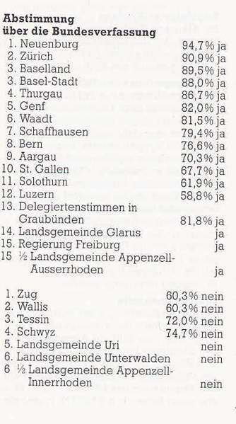
1848: 70 per cent of the Cantons accept the new Constitution
Notes:
Der Verfassungsvorschlag wurde 1848 der Volksabstimmung unterbreitet.
Gabe es hier nicht einen Trick? -> Linder, S. 29.
Da es noch kein Schweizervolk gab, stimmten die Kantone im Rahmen ihrer eigenen politischen Ordnung darüber ab.
In GR und FR entschied das Parlament im Namen des Volkes
In LU kam die Zustimmung deshalb zustande, weil die 30 Prozent Abstinenten den Ja-Stimmen zugerechnet wurden.
Für den Zusammenschluss des Staatenbundes zum Bundesstaat wäre eigentlich die Zustimmung aller Stände notwendig gewesen. Die freisinnige Mehrheit definierte die Regeln jedoch anders und verlangten eine genügende Mehrheit. Nachdem zwei Drittel der Kantone zugestimmt hatten, gab die Tagsatzung bekannt, dass die neue Bundesverfassung angenommen war.

Slide 23
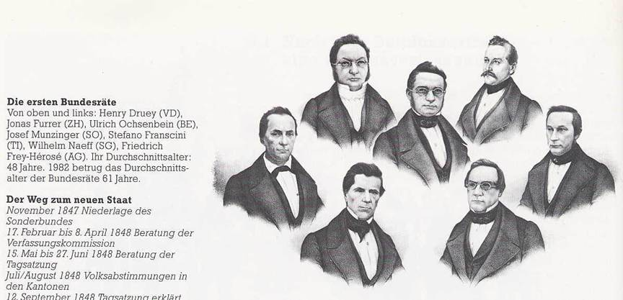
The first Swiss government

Slide 24
From a Confederation to a Federal State
Federalism, the only solution
Two chambers (following the US example)
Very limited power for the central state
Modification of the Constitution have to be accepted by the cantons and the citizens
Residual competences in the hand of the cantons (“bottom-up federalism”) -> diversity
Equalization of differences

Slide 25
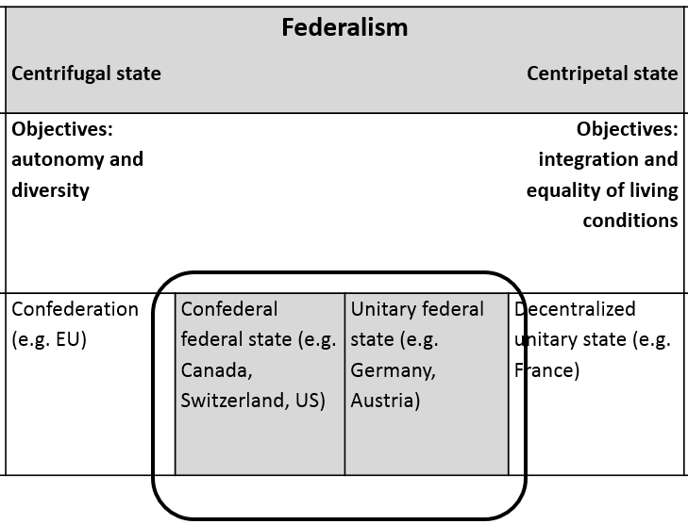
Autonomy and diversity instead of equality of living conditions
Quelle: Stalder, Kurt (1999). Föderalismus und Finanzausgleich. Schriftenreihe der Fachgruppe für kantonale Finanzfragen. Solothurn: Verlag FkF.

Slide 26
Swiss Federalism: basic characteristics
The existence of the cantons is guaranteed
The cantons are free to organize themselves internally
The cantons elect their own authorities
The cantons dispose of far reaching competences
The cantons dispose of their own financial resources
There is no political control ruling over the cantons
The cantons participate equally in the decision making process on federal level

Slide 27
Topics
Heterogeneous society
Federalism and Decentralisation
Financial Autonomy, Transfers, Equalization, and Direct Democracy

Slide 28
(26 cantons and) 2222 municipalities

Slide 29
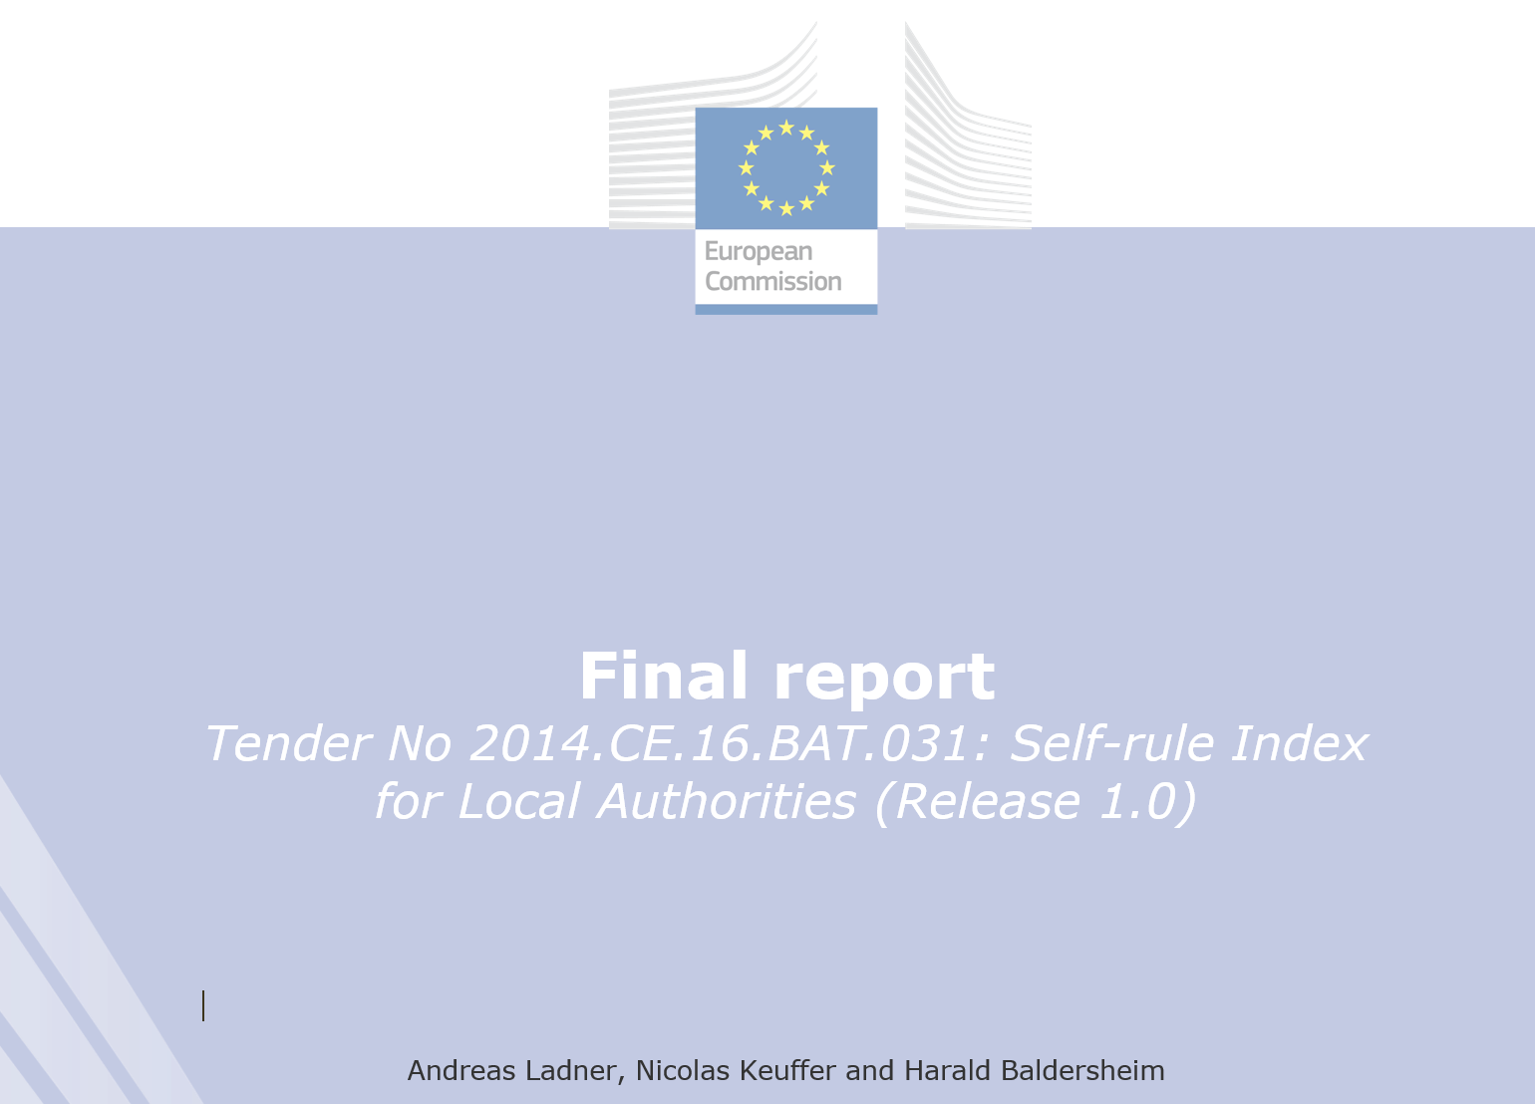

Slide 30
Indicators of local autonomy (I)
Institutional depth (ID): The extent to which local government is formally autonomous and can choose the tasks they want to perform.
Policy scope (PS): Range of functions (tasks) where local government is effectively involved in the delivery of the services (be it through their own financial resources and/or through their own staff.
Effective political discretion (EPD): The extent to which local government has real influence (can decide on service aspects) over these functions.
Fiscal autonomy (FA): The extent to which local government can independently tax its population.
Financial transfer system (FTS): The proportion of unconditional financial transfers to total financial transfers received by the local government.

Slide 31
Indicators of local autonomy (II)
Financial self-reliance (FSR): The proportion of local government revenues derived from own/local sources (taxes, fees, charges).
Borrowing autonomy (BA): The extent to which local government can borrow.
Organisational autonomy (OA): The extent to which local government is free to decide about its own organisation and electoral system.
Legal protection (LP): Existence of constitutional or legal means to assert local autonomy.
Administrative supervision (AS): Unobtrusive administrative supervision of local government.
Central or regional access (CRA): To what extent local authorities are consulted to influence higher level governments’ policy-making.

Slide 32
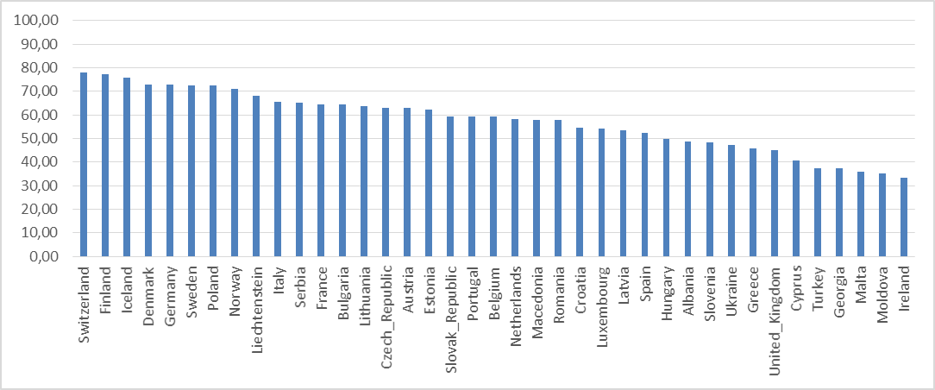
«Country Ranking 2014»

Slide 33
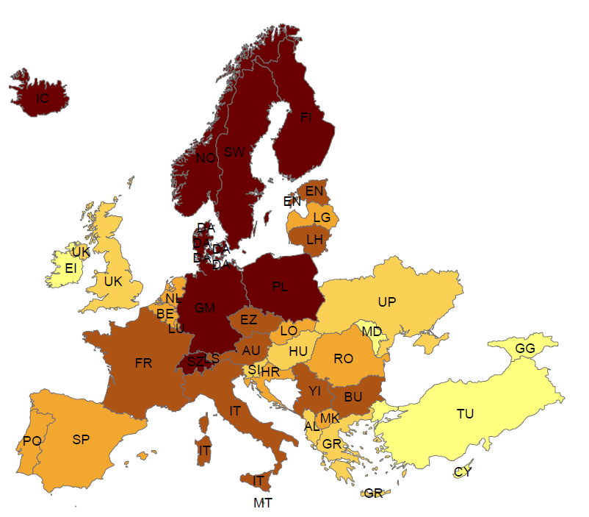
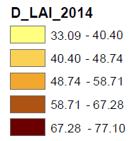
Local autonomy index (LAI_2014)

Slide 34
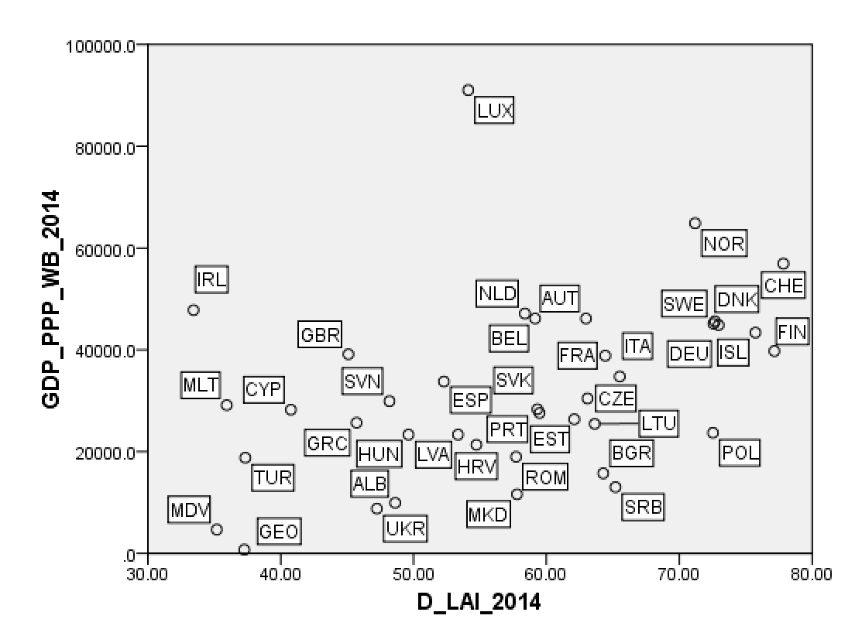
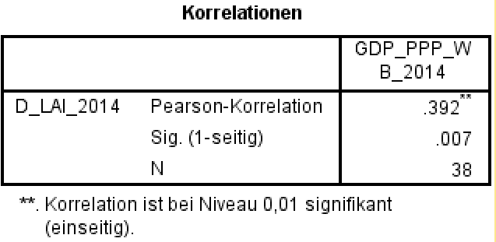
Local autonomy and GDP_PPP

Slide 35
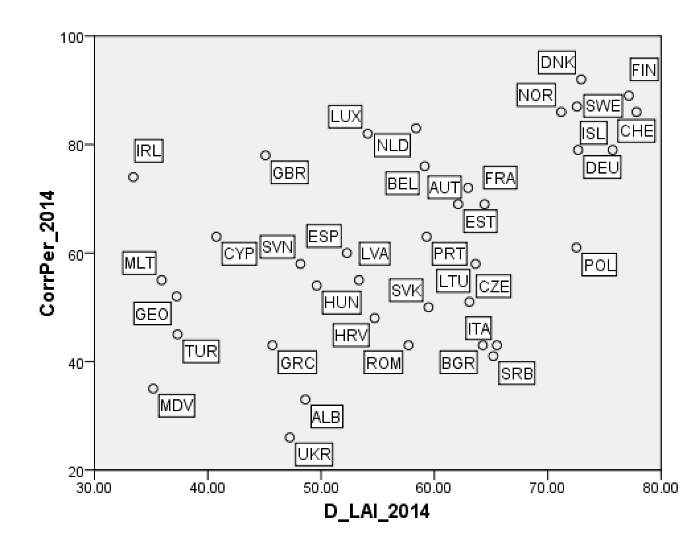
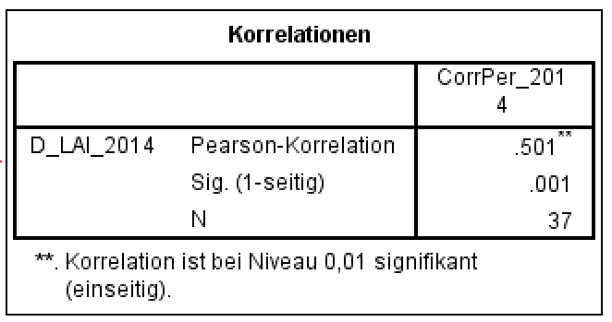
Local autonomy and corruption

Slide 36
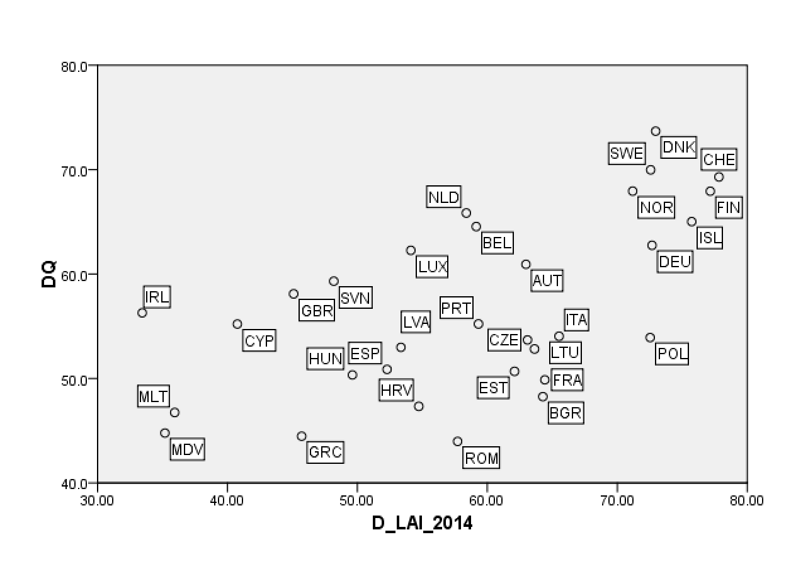
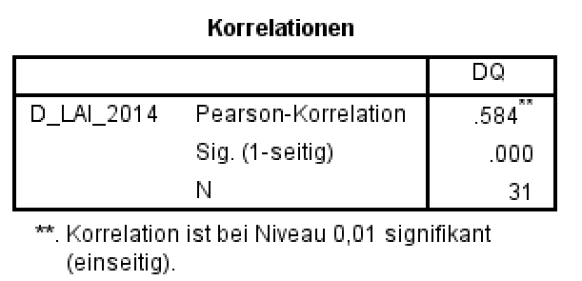
Local autonomy and democracy

Slide 37
Local autonomy and happyness

Slide 38
But …
Decentralization does not automatically lead to economic success. Both are results of long, continuing and interdependent processes
Autonomy goes hand in hand with diversity

Slide 39
Inequalities between the cantons and municipalities are inevitable

Slide 40
22.0 mrd.
2014/2013
National gov.
rev.: 64.9 mrd.
exp.: 64.7 mrd.
National tasks:
defense, IR, social security
_____
Cantonal tasks:
education, health, police
_____
Local tasks
primary school,
social assistance, land use, water, waste etc.
29 mrd.
TVA
Income Tax
18.3 mrd.
24.7 mrd.
Cantonal govs.
rev.: 82.7 mrd.
exp.: 85.0 mrd.
42.3 mrd.
74.1 mrd.
3 mrd.
26.0 mrd.
Local govs.
rev.: 45.5 mrd.
exp.: 46.1 mrd.
37.3 mrd.
Citizens
1 Mrd.= 1’000’000’000
Social Security not included (59.8 mrd.)
Health systems only partly included

Slide 41
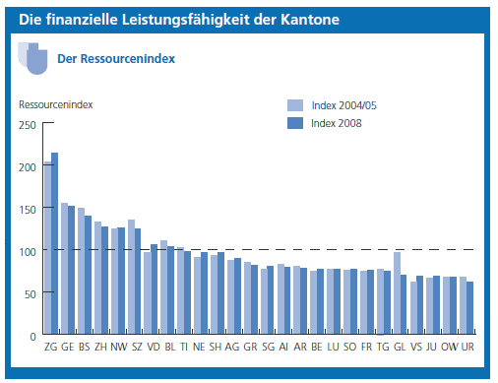
The rich and the poor

Slide 42
Problem to be solved
Equalization

Slide 43
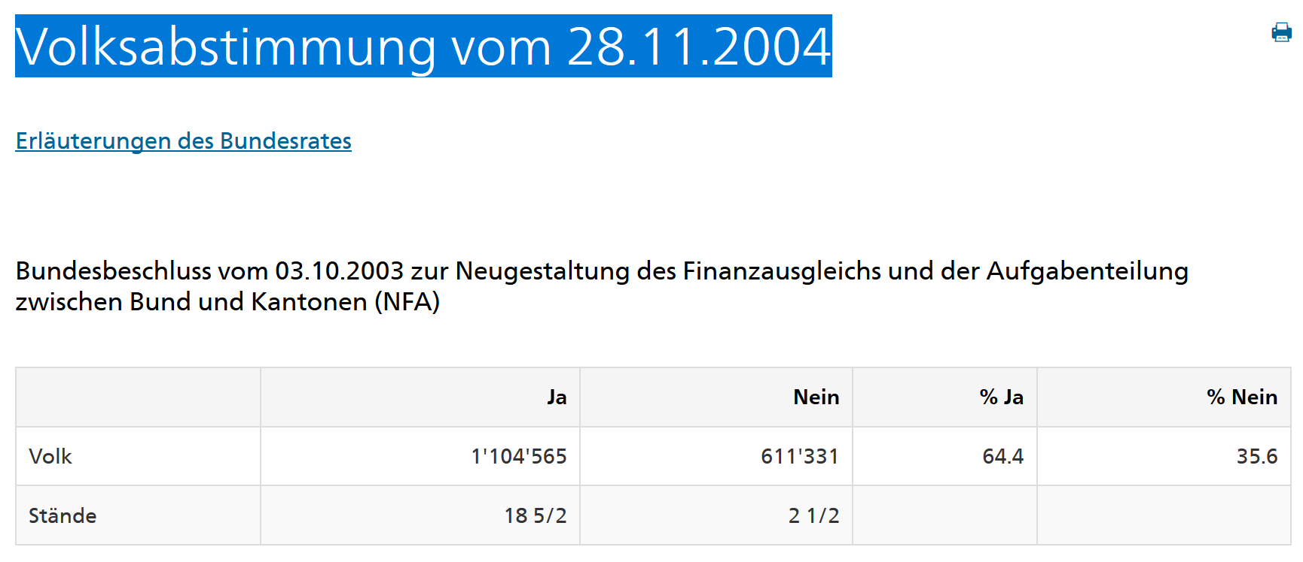
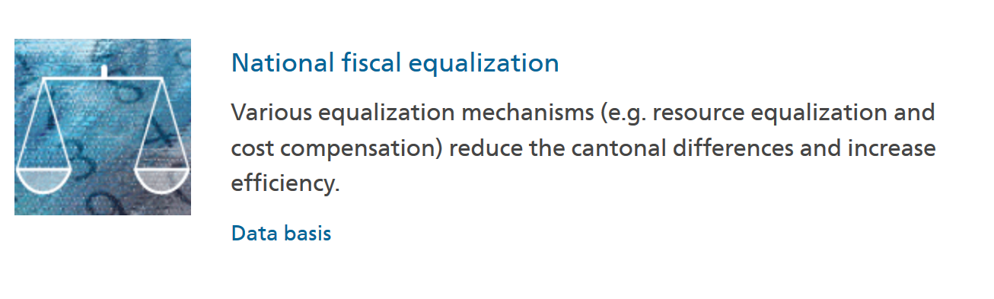
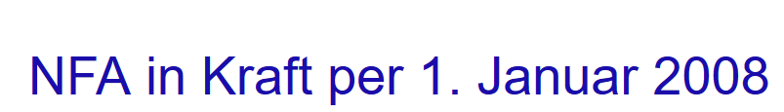

Slide 44
The new financial equalisation scheme
On the financial side, the equalization of resources will guarantee a minimal amount of income to each canton.
In the new system, the former “index of financial strength” is replaced by a “resource indicator”. The resource indicator measures the resource potential.
The resource indicator is calculated on the basis of taxable income and wealth of the natural persons (inhabitants) and the profits of the juristic persons (business, firms, enterprises).
Additionally there is a compensation system for higher costs (geography, socio-demographics).

Slide 45
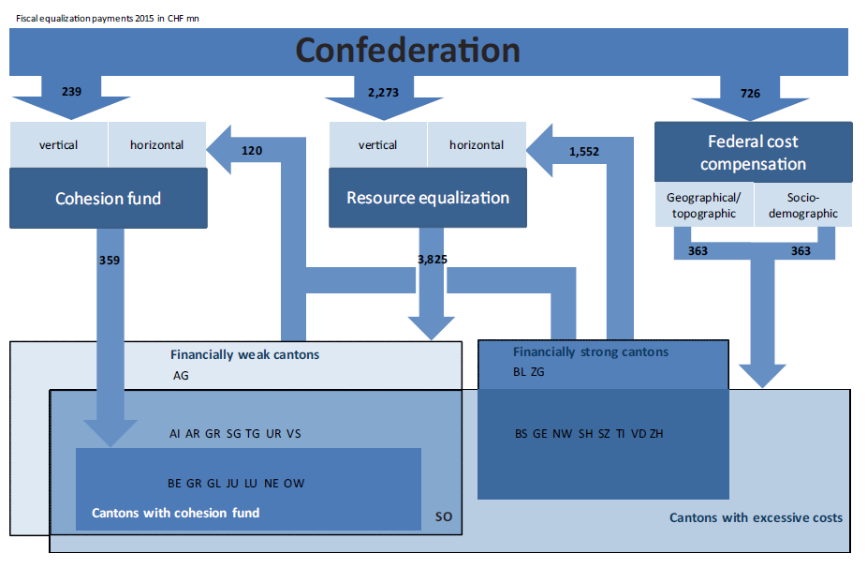

Slide 46

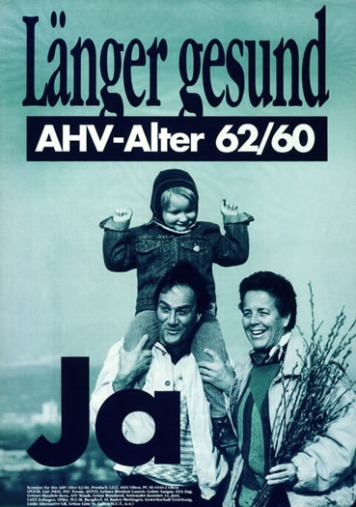
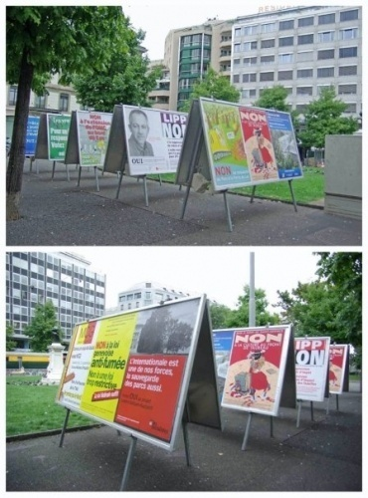


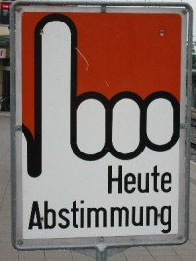
Direct Democracy

Slide 47
The compulsory referendum (obligatorisches Referendum):
Changes of the local code (Gemeindeordnung) and important public expenditures have to be brought to a vote.
Any expenditures or projects exceeding 10 Mio. sFr. or recurrent expenditures of more than 500'000 sFr. have necessarily to be accepted by the citizens.

Slide 48
The optional referendum (fakultatives Referendum):
A (positive) decision of the city's parliament can be questioned with a referendum
a) when a majority of the members of parliament decide so during the same session,
b) when within 20 days after the official announcement of this decision at least 4000 citizens demand a vote, and
c) when within 20 days one third of the members of parliament asks for it (written request).

Slide 49
An enormous amount of decisions to be taken
In his/her politically active life a citizens is asked to decide on between 1600 and 1800 issues.

Slide 50
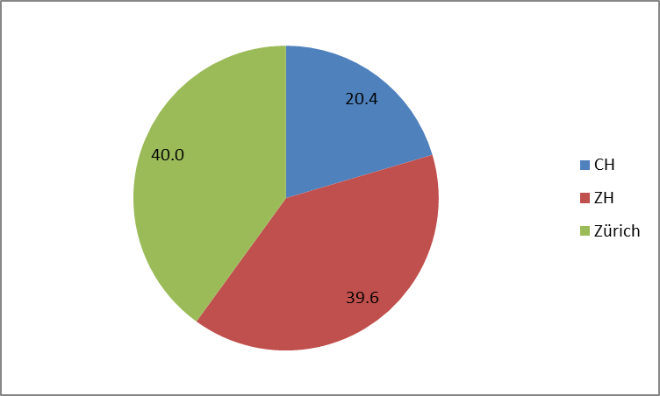
City of Zürich: 1933 – 2013: 2287 issues

Slide 51
Citizens/tax payers – Local authorities/civil servants
Financial autonomy and direct democracy
High legitimacy, trust and …?

Slide 52
Thank you for your attention!

